Slide 1
American Immigration
State Standards 6.4 and 6.5

Slide 2
Intense Changes
Industrialism Changes
19th and early 20th centuries were a time of intense changes in America
Industrialization transforms the economy and reshaped the social, cultural, and physical landscape of the country
Most intense changes results from the influx of immigrants into the US

Slide 3
Old Immigration
Nation of Immigrants
The United States has always been a country made up of people who are not native to this country
Second Half of 19th Century
Immigrants during this time period mostly came from Europe
Known as Old Immigration

Slide 4
Old Immigration.
Irish Potato Famine
Many Irish immigrants came here to escape the famine in their home country
Resulted from a series of crop failures that led to over one million Irish immigrants

Slide 5
Old Immigration..
Germany
Peasants in Germany failed to overthrow the monarchy in the country and fled to America as a result
Old Immigrants were forced to endure harsh travel in order to seek economic, political, and religious freedom

Slide 6
New Immigration
Occurred closer to the 20th Century
New Immigrants emigrated from Southern and Eastern Europe
Sought to escape religious and political persecution
These immigrants triggered hostilities
Typically looked different, did not speak English, and were often Catholic or Jewish
1860-1920
25 million immigrants arrived

Slide 7
New Immigration.
Ellis Island
Point in New York where most immigrants first arrived in the US
Statue of Liberty

Slide 8
Changing Demographics
1860
813,000 people living in New York City
47% of the population was foreign
Immigrants bring their culture with them
Neighborhoods like Little Italy, New Ireland, and Chinatown take shape
Immigrants from common backgrounds tended to group together
Most immigrants settled in cities but some moved out West

Slide 9
Growing Cities
1900
Three cities with populations over 1,000,000
New York, Chicago, and Philadelphia
Tenement Living
Small, cramped five or six story apartment buildings that sometimes had no heat, electricity, or running water
Entire floors shared one bathroom, garbage piled up outside, often burned down from candle fires, entire families lived in two to three rooms
Jacob Riis
How the Other Half Lives

Slide 10
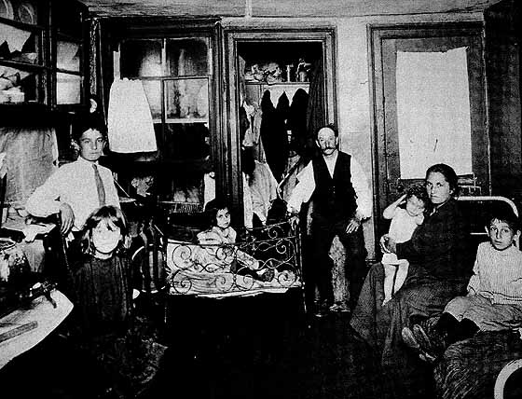
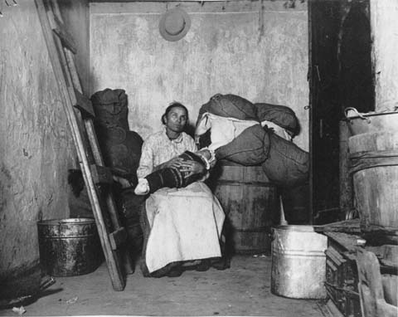
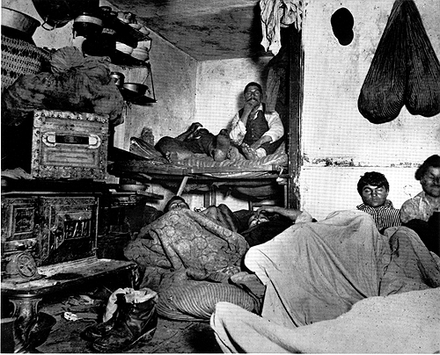
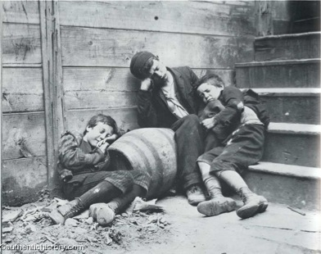

Slide 11
Immigration Backlash
Rising Immigrant populations spur racist attitudes
Nativism
Racist group who considered themselves “native” Americans
Know-Nothing Party
Nativist political party that ran on an anti-immigration platform

Slide 12
Immigration Backlash.
Yellow Peril
Asian Immigrants described as this because they threatened to undermine others’ opportunities by working jobs for lower wages
Chinese Exclusion Act
Chinese were the first group targeted by immigration restriction

Slide 13
Immigration Backlash..
Johnson-Reed Act of 1924
Established quotas that limited immigration from different parts of the world
Quotas were based on the number of immigrants already living in the US
This system discriminated against immigrants from eastern and southern Europe
Asians and Japanese immigrants were excluded

