Slide 1
American Imperialism
“Gold, God, Glory”

Slide 2
Monroe Doctrine
US foreign policy regarding Latin American countries in 1823.
It stated that further efforts by European nations to colonize land or interfere with states in North or South America would be viewed as acts of aggression, requiring U.S. intervention.
European countries should stay out of the affairs of the Western Hemisphere

Slide 3
American Expansion
By the 1880s many American leaders had become convinced that the US should join the imperialist powers of Europe and establish colonies overseas
Imperialism is the policy in which stronger nations extend their economic, political, or military control over weaker territories
Imperialists competed for territory in Africa and Asia
Most Americans gradually warmed to the idea of expansion overseas
3 factors fueled American imperialism:
Desire for military strength
Thirst for new markets
Belief in cultural superiority

Slide 4
American Expansion
Frederick Jackson Turner – Frontier Thesis
Closing of the American Frontier (Manifest Destiny)
A great chapter in American history has ended
Natural Resources??

Slide 5
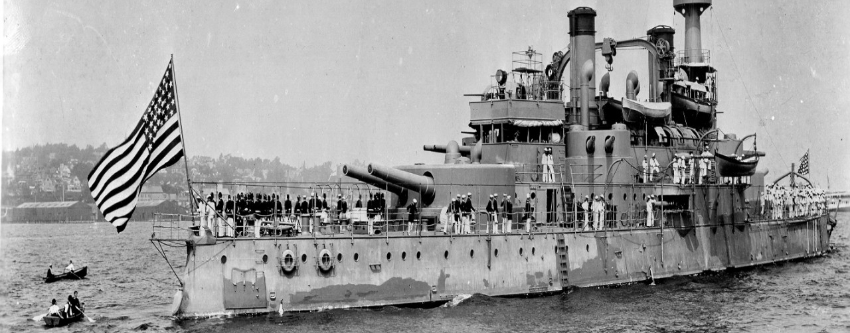
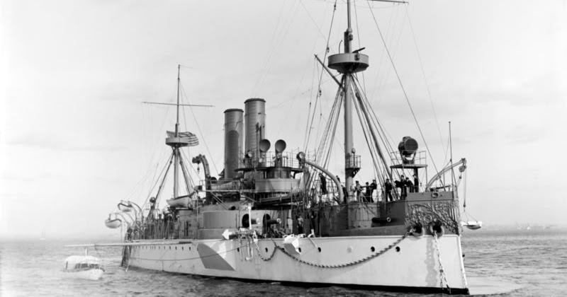
Desire for military strength
Admiral Alfred T. Mahan of the US Navy urged government officials to build up American Naval power in order to compete with other powerful nations
The Influence of Sea Power upon History
As a result, the US built 9 steel-hulled cruisers
2 of the most famous were the Maine and the Oregon

Slide 6
Thirst for New Markets
Advances in technology enabled American farms and factories to produce a surplus of goods
The US needed raw materials for factories and new markets for its agricultural and manufactured goods
Imperialists viewed foreign trade as the solution to American overproduction
Bolstered by the Panic of 1893

Slide 7
Belief in Cultural Superiority
Some Americans combined the philosophy of Social Darwinism (survival of the fittest and racial superiority of Anglo-Saxons)
Argued that the US had a responsibility to spread Christianity and “civilization” to the world’s “inferior people”
Teddy Roosevelt made a distinction between “civilized” and “uncivilized” peoples.
Civilized – Those people or nations that produced goods from raw materials
Uncivilized – Those people or nations that supplied raw materials

Slide 8
Hawaii
Originally an independent monarchy
Many missionaries to Hawaii became wealthy and powerful by owning sugar plantations
Began to heavily export sugar from Hawaii to US
To avoid paying tariffs the US plantation owners wanted the US to annex Hawaii
Planters and missionaries take control of Hawaii

Slide 9
Hawaii.
Queen Liliuokalani
Queen of Hawaii who was jailed
Hawaii was annexed in 1898
Plantation owners gained much impact on the government
1959
Hawaii votes to become the 50th state

Slide 10
Search For Raw Materials
Imperialist countries searching
Open Door Policy – forcibly open trade relations with Japan and China
China was divided into Spheres of Influence
Each imperialist country was given a sphere in which it could control trade

Slide 11
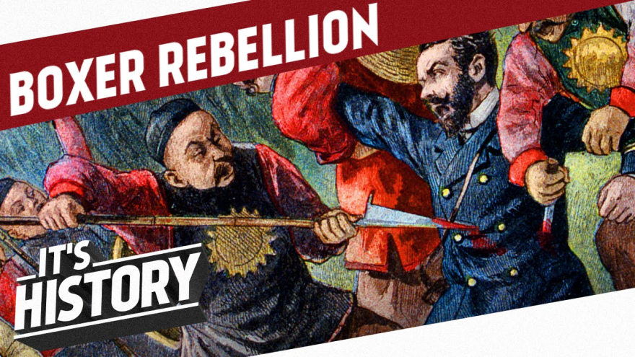
Search for New Markets
The Boxer Rebellion
Chinese militia group known as the fists of righteous harmony (the boxers) rebel against western influence.

Slide 12
The Spanish-American War
Spain ruled Cuba
Uprising occurred in 1895
Leader was Jose Marti
United States declares neutrality
Many in Congress wanted to intervene
Why? - SUGAR

Slide 13
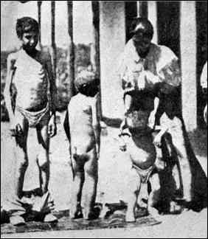
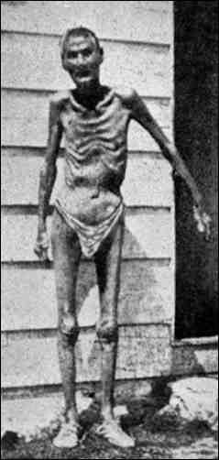
General Weyler’s Cuban Policy
Use concentration camps to control the population
As a result, Americans become sympathetic for Cuban cause

Slide 14
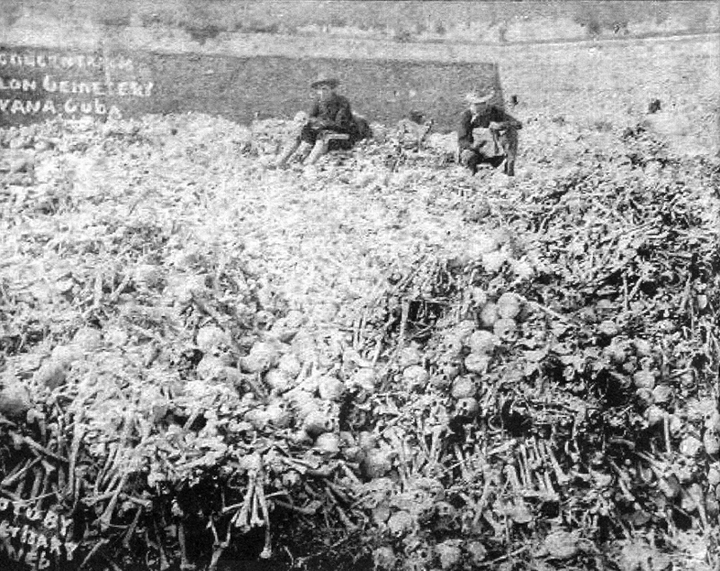

Slide 15
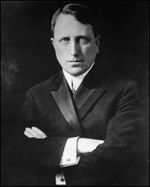
The Spanish American War.
Yellow Journalism
Sensationalized press and reports to sell papers
Bolstered interest in Cuba
Sensationalized events in Cuba in a way to boost sales and incite public opinion
Joseph Pulitzer – New York World
William Randolph Hearst – New York Journal

Slide 16
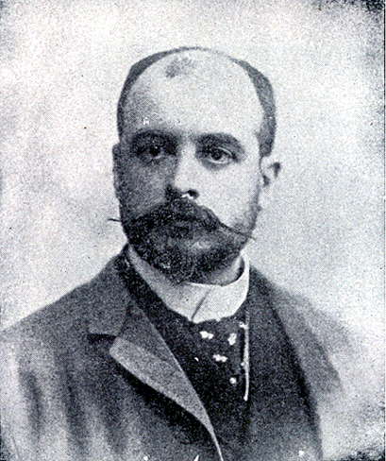
De Lôme Letter
Dupuy de Lôme, Spanish Ambassador to the U.S.
Criticized President McKinley as weak
Insult to national pride
Jingoism- Extreme/Warlike Nationalism
Leads to increasing tension between Spain and U.S.

Slide 17
The Spanish American War..
USS Maine
American ship that was anchored in Havana Harbor
Inexplicably blew up
266 American Sailors die
Hearst and Pulitzer jump at the chance to capitalize on passions for war against Spain “Remember the Maine”
A free Cuba was an opportunity for economic expansion

Slide 18
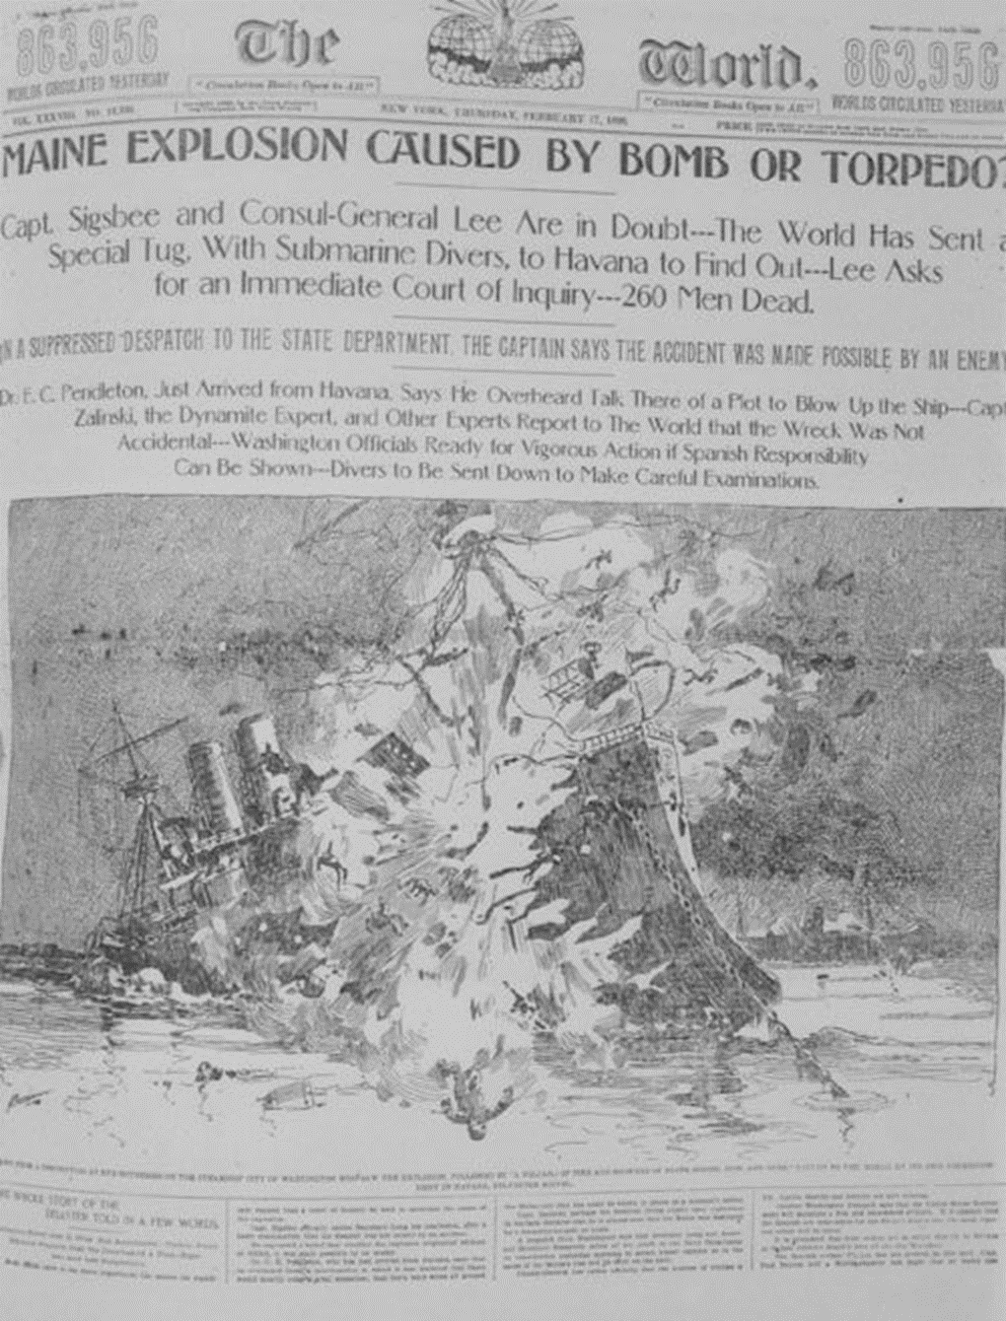

Slide 19
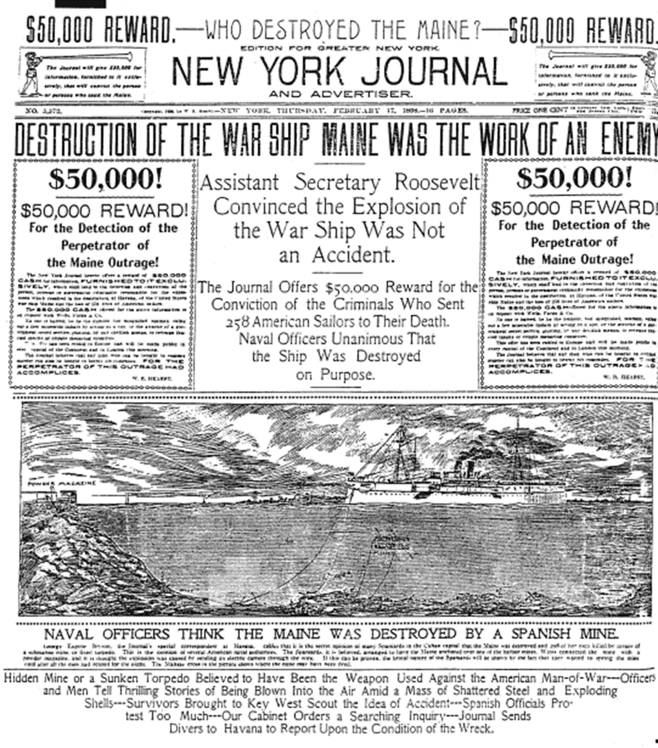

Slide 20
The Causes of the Spanish American War
Sugar
Yellow Journalism
De Lome Letter
The Explosion of the Maine
Jingoism

Slide 21
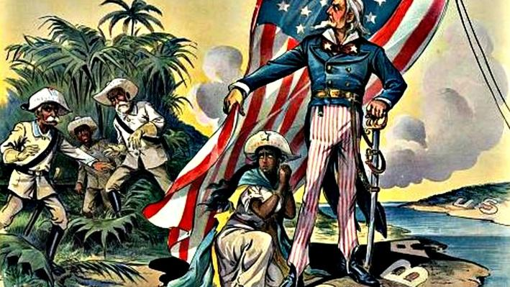
The Spanish American War…
“A Splendid Little War” –Secretary of State John Hay
Battle of San Juan and Kettle Hill
Rough Riders under the command of future President Theodore Roosevelt

Slide 22
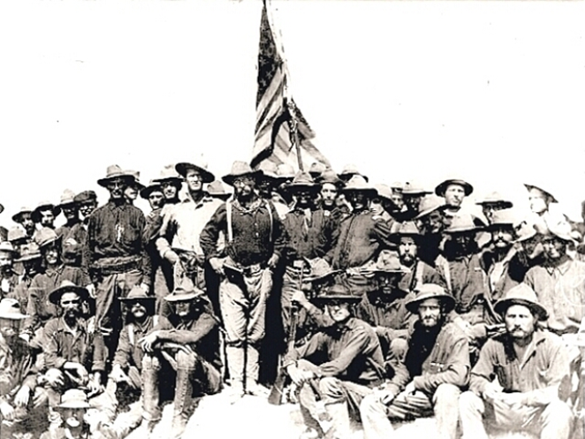
The Spanish American War…
Battle of San Juan and Kettle Hill
Rough Riders: Volunteer Cavalry under the command of future President Theodore Roosevelt

Slide 23
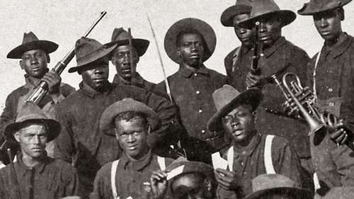
The Spanish American War
Buffalo Soldiers: All black regiment who fought along the Rough Riders.
Gained fame in the United States but Armed Forces remained segregated

Slide 24
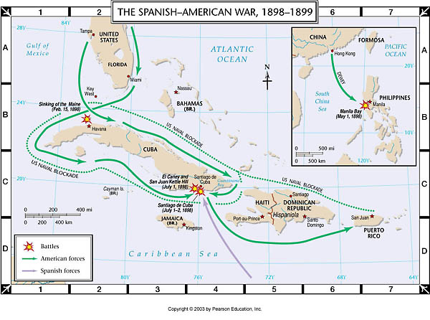
The Spanish American War
Spain is defeated in Cuba and Puerto Rico in less then 5 months

Slide 25
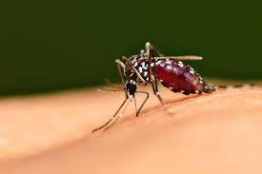
The Spanish American War
5,000 soldiers die in Cuba
Less then 500 will die in combat
Cuba, Puerto Rico, and Guam are given to the United States – What about the Philippines?

Slide 26
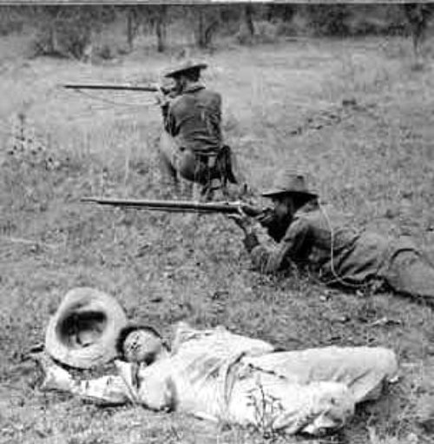
The Spanish American War….
Philippines
US defeats Spanish Navy and takes control of Manila
Lead by Emilio Aguinaldo
Rebels declare the Philippines independent of Spain
Failed revolt against American rule followed which failed
Filipino-American War (Philippine Insurrection)

Slide 27
The Outcomes of War
1901
US grants Cuba independence
Teller Amendment
1898 – Help win independence and leave
Platt Amendment
Cuba could not make treaties with other nations that were against American interests
Gave America control of the naval base at Guantanamo Bay
Foraker Act – Puerto Rico establishes pro-American government

Slide 28
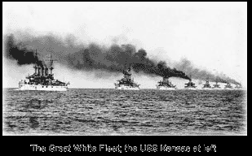
Alfred Thayer Mahan
“The Influence of Sea Power Upon History”
The Great White Fleet
Teddy Roosevelt – “Civilized” vs “Uncivilized” Nations

Slide 29
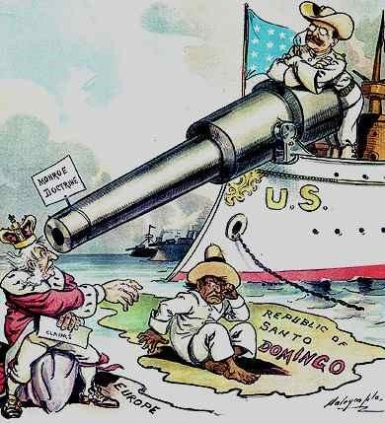

Slide 30
William McKinley – Imperialism!
1. Spanish American War
2. Annexed Hawaii
3. Acquires Samoan Islands
4. Open Door Policy
5. Foraker Act

Slide 31
Teddy Roosevelt – Panama Canal
*The United States supported a revolution by the Panamanians to free themselves against the Columbian government*
France
1881-1887
France attempts to build a canal across the Isthmus of Panama
1903
US signs a treaty that granted it a permanent lease over a 10 mile wide swathe across the isthmus for $10 million
Access point for trade with new territories

Slide 33
Big Stick Diplomacy
Big Stickism
“Speak softly and carry a big stick”
Teddy Roosevelt’s idea for foreign policy
Roosevelt Corollary to the Monroe Doctrine
Establishes the US as the policing force of the Western Hemisphere
Roosevelt want no interference from European powers in the Western Hemisphere

Slide 34
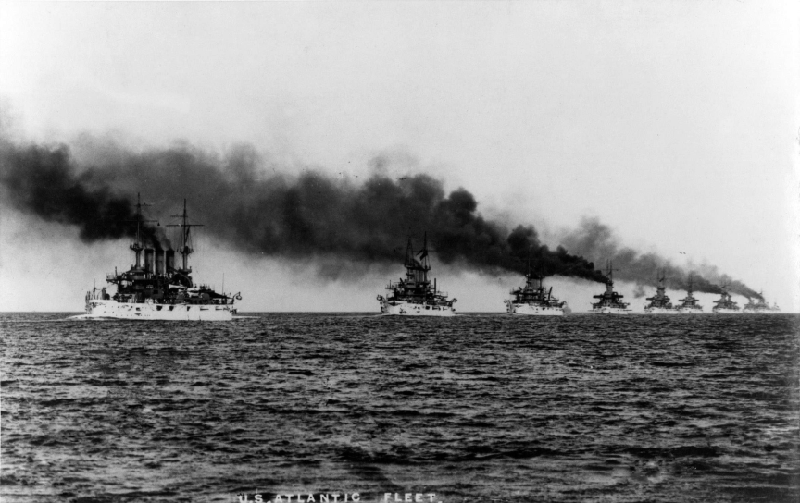
Big Stick Diplomacy
Russo-Japanese War
Roosevelt will win the Nobel Peace Prize for acting as an arbiter between Russia and Japan
Secures trade rights with Manchuria
Great White Fleet
The Influence of Sea Power upon History (Alfred Thayer Mahan)
Supports Panama revolt against Colombian wishes
Supports Venezula against Germany and sends the military to the Dominican Republic

Slide 35
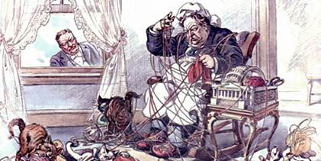
William Taft – Dollar Diplomacy
Dollars instead of bullets – influencing the western hemisphere through the economy

Slide 36
Woodrow Wilson
1. Moral Diplomacy – Every country should aspire to be like the United States and would benefit from democracy
2. Establishes military government in Dominican Republic
3. Sends troops to Haiti to establish new constitution
4. Acquires the Virgin Islands
5. Mexico

Slide 37
Woodrow Wilson
Mexico
Porfirio Diaz: Corrupt leader dominated by American businessmen
Francisco Madero: Overthrows Diaz and promises democratic reforms but hostile to American business
Victoriana Huerta: general encouraged by the U.S. under the Taft administration to overthrow Madero
Huerta overthrows the government but murders Madero just before Wilson takes office
“Never recognize Huerta’s government of butchers”
Venustiana Carranza: Constitutionalists supported by Wilson
Wilson seizes Vera Cruz, small battle ensues, Carranzas forces take Mexico City but do not overhaul government
Possible backing of Pancho Villa?

