Slide 1
Causes of World War II
State Standards 8.1 and 8.3

Slide 2
Totalitarianism
Totalitarianism
Control of political, economic, social and cultural aspects of life
Led by a single leader and party
Not interested in individual freedom (civil liberties)
Used modern technology and propaganda

Slide 3
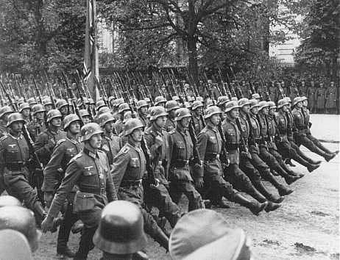
Totalitarianism.
Dictators gave way to Totalitarianism in three countries
Soviet Union (Russia)
Italy
Germany

Slide 4
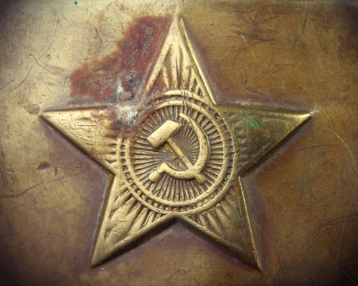
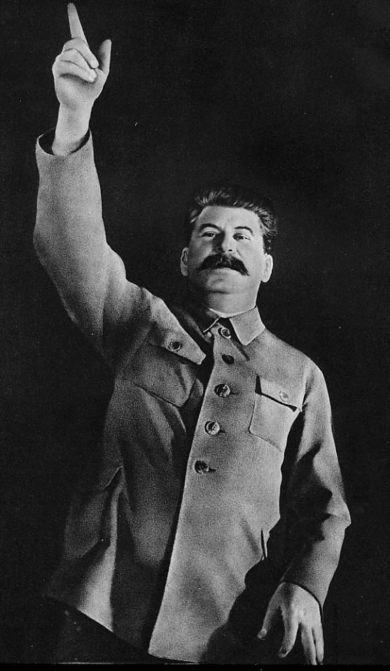
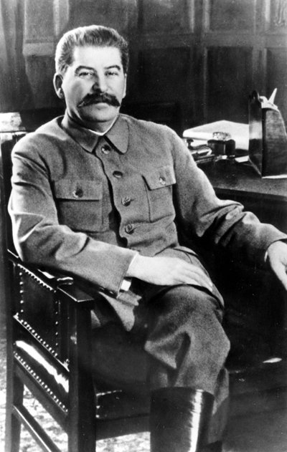
Russia
Lenin and the Bolsheviks
Bolsheviks win the Russian Revolution by beating the White Army
Lenin’s leadership pivotal
Lenin Dies
Leadership crisis follows
Trotsky vs. Iosif Dzhugashvili (Stalin)
Stalin means “man of steel”

Slide 5
Russia.
Stalin
Starts out as Secretary General
Uses this position to grow his power by eliminating competitors
Sends enemies to the Gulag
Becomes the dictator of the Russian state
Establishes a powerful Communist State
Creates three five year plans to rebuild the Russian economy
http://www.history.com/videos/joseph-stalin#joseph-stalin

Slide 6
Russia..
Collectivization
Involved total government control of all economic activity, especially what was produced and how
Five Year Plan
Sought to industrialize Russia and collectivize farms as quickly as possible

Slide 7
Russia…
Political Purges
Stalin purges the entire government to eliminate all of his enemies
Solidified his dictatorship
Show Trials
People forced to plea guilty to crimes they did not commit

Slide 8
Italy
Economic Struggles
No jobs and prices begin to climb
Fascism in Italy
Benito Mussolini
Becomes the leader of the Fascist Party in Italy
Fascism
A form of socialism, state owned and operated economy

Slide 9
Italy.
Benito Mussolini
Leads the Fascist Party’s military wing
Black Shirts
Mussolini threatens to have his Black Shirts march on Rome to seize power
King Victor Emmanuel allows Mussolini to become premier in a coalition cabinet
The King did this because he knew Mussolini favored keeping the monarchy

Slide 10
Italy..
Benito Mussolini
Fascist force out all other political parties and create a single party dictatorship in Italy
Mussolini’s fascist government was a more relaxed version of Nazism
Mussolini known as El Duce
Wanted to restore Italy to its former glory
http://www.history.com/videos/benito-mussolini#benito-mussolini

Slide 11
Japan
Torn apart by political and economic conflict
Military leaders used violence to gain control over the government.
Emperor Hirohito
Godlike leader of the government
Hideki Tojo
Leader of the military faction of the government
Held most of the power
They were inspired by nationalistic dreams of Japanese greatness.

Slide 12
Japan.
Without government approval, some Japanese generals invaded the Chinese province of Manchuria to gain land and resources for Japan.
This demonstrated the weakness of the Japanese government and the strength of Japanese nationalists.

Slide 13
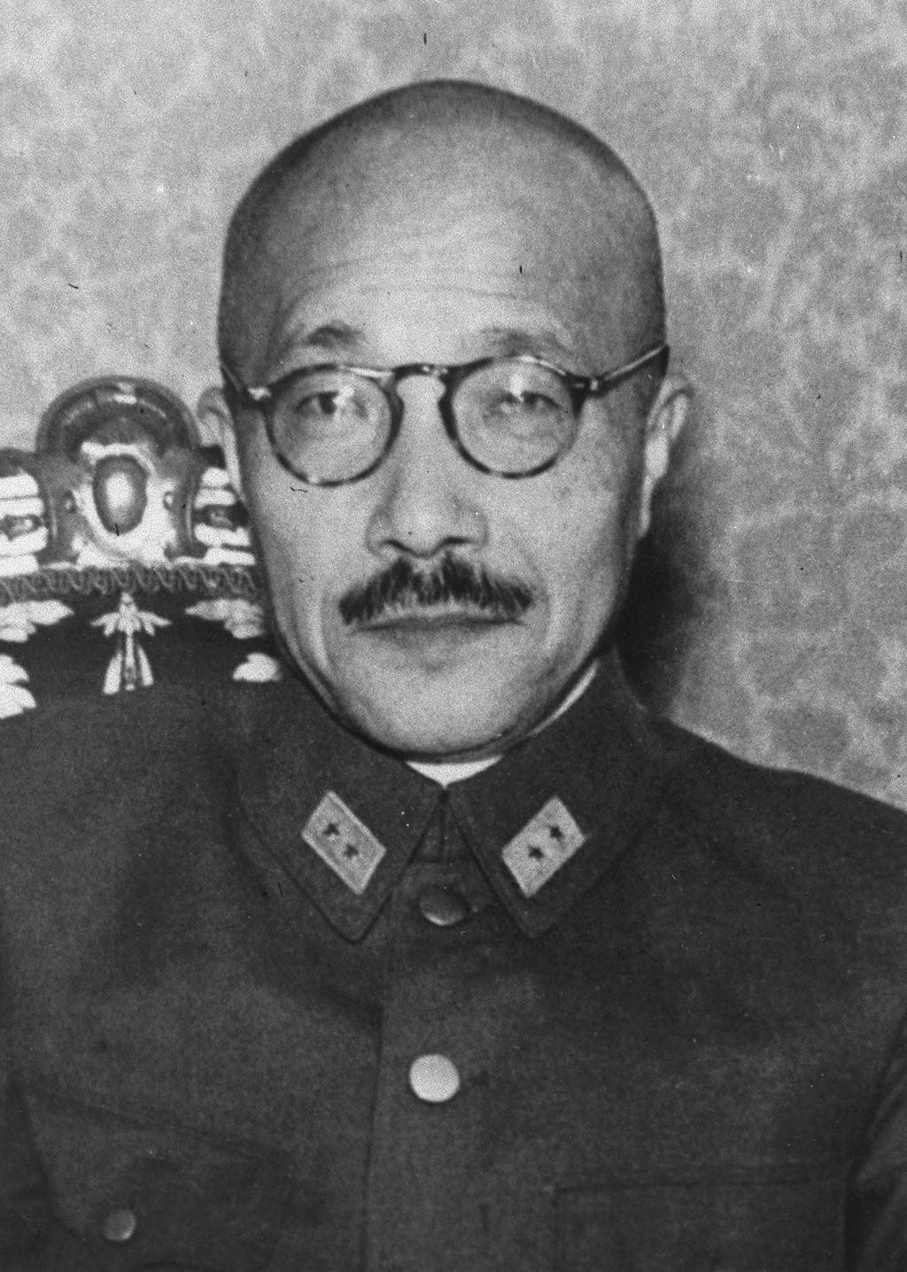
Dark Clouds on the Horizon
Three of the most powerful countries in the world were now controlled by single leaders
Stalin in Russia
Mussolini in Italy
Tojo in Japan

Slide 14
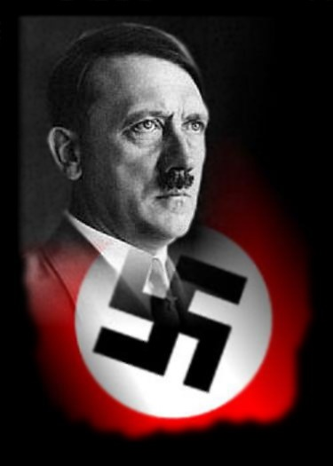
Dark Clouds on the Horizon.
The economic crises of the Great Depression had directly led to this rise of dictators
The world would never be the same after these dictators were done with the world
The fourth and most powerful dictatorship was yet to come
Nazi Germany

Slide 15
Hitler’s Early Life
http://www.history.com/topics/adolf-hitler/videos#adolf-hitler
Poor student
Dropped out of school at 16
Wanted to become an artist or architect but could not gain admission to any schools to study
Military Career
Joins German Army when World War I starts
Served as a dispatch runner at the front
Wounded twice
Earned five medals

Slide 16
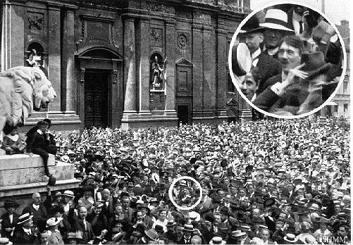

Slide 17
Hitler’s Influences
“Stab in the back story”
Believed German politicians of the Weimar Republic had stabbed the German army in the back by not continuing to fight the war
Hitler joins the German worker’s Party
A small extremist political group

Slide 18
Hitler’s Abilities
Political Oratory
When Hitler spoke he had an astonishing ability to dominate his party members by the force of his personality
Speech Video
1921
Hitler voted the Fuhrer (leader) of the renamed National Socialist Germany Workers’ Party (NAZI)

Slide 19
The Nazi Party
Violently Nationalistic
Storm Troopers (SA)
The Nazi’s military force
Anti-Semitic
Opposed to the democratic republican government
Considered guilty of treason
Looked upon the German people as superior to other races and believed the Jews were an inferior race

Slide 20
Beer Hall Putsch
Nazis attempt to seize control of the government
Failed miserably
Hitler and other party leaders arrested and tried for high treason
Hitler becomes a national figure

Slide 21
Hitler in Prison
While in prison he writes Mein Kampf (My Struggle)
Book about Hitler’s major views
Outlined his belief in the superiority of the Aryan Race
Outline his plan for taking control of Europe
Conquest of Lebensraum
Living space for the German people

Slide 22
Hitler’s Entourage
Josef Goebbels
Headed the party’s propaganda division
Held a low regard for the intellect of the masses and believed people would respond well to emotional appeals centered around their own hatred

Slide 23
Hitler’s Entourage.
Hermann Goering
Commanded the SA before fleeing the country after the failed Beer Hall Putsch
Returned to serve Hitler in various capacities when he was released from jail

Slide 24
Hitler’s Entourage..
Heinrich Himmler
Former chicken farmer
Takes command of Hitler’s personal bodyguard
Schutz Staffel (SS)
Swore allegiance to Hitler alone
In charge of carrying out the Final Solution
Hitler’s plan to exterminate all Jews

Slide 25
To Total Power
Deal with Papen
Hitler makes a deal with Papen to become Chancellor
Hitler’s Nazi Party already held the majority in the government
Papen figured that Hitler would turn into his puppet

Slide 26
To Total Power.
To Power
Hitler quickly dissolves the government
Eliminates all political parties
Becomes the complete dictator of Germany

Slide 27
Dictator
Hitler Youth
Youth organization that fostered love for the Fuhrer and exalted certain warlike virtues
Third Reich
Hitler’s name for his new Empire
First Reich=Holy Roman Empire
Second Reich=World War I Germany
Hitler predicts his new Reich will last 1,000 years

Slide 28
Dictator.
Hatred towards Jews
Purged Jews from important jobs
Gestapo
Secret Police that begins to relentlessly track down enemies of the state
Constantly hunted down Jews
“Night of long knives”
Night where the Gestapo eliminates all of Hitler’s enemies

Slide 29
Isolationists
America wants to remain isolated
Isolationism
Not becoming involved in other nation’s issues
American Neutrality Act
Made US neutral but allowed US to sell weapons to allies
Lend Lease Bill
Allowed the President to lend or lease war products to Britain that would be paid for after the War

Slide 30
Japan’s Aggression
Japan as the Aggressor
With the fall of the Netherlands and France Japan began to take over their Pacific territories
Japan conquers Manchuria
Japan invades China
Rape of Nanking

Slide 31
American Policy Toward Japan
American Embargo
America creates an embargo that stopped its exports of aviation fuel and iron to Japan
This made it so that Japan has no resources to supply their Empire

Slide 32
Between A Rock and A Hard Place
Problems for Japan
Because of Embargos Japan has no way to supply its military
Japan is an island with very limited resources
Had to find these resources somewhere
What Should Japan Do?
Attack and gain resources or stay at peace and slowly lose its new Empire?
http://www.history.com/topics/pearl-harbor/videos#richard-young-recalls-pearl-harbor

Slide 33
Japan’s Choice
ATTACK!
Admiral Yamamoto
Commander of the Japanese Combined Fleet
Knows if Japan is to be successful they must destroy America’s Pacific Fleet
Decides to attack the American Fleet at Pearl Harbor, Hawaii
http://www.history.com/topics/pearl-harbor/videos#pearl-harbor-is-attacked

Slide 34
Pearl Harbor
December 7th, 1941
Radar station on Hawaii detects oncoming Japanese planes
Report is ignored because operators think it is an expected shipment
http://www.history.com/topics/pearl-harbor/videos#uss-arizona-under-attack-at-pearl-harbor

Slide 35
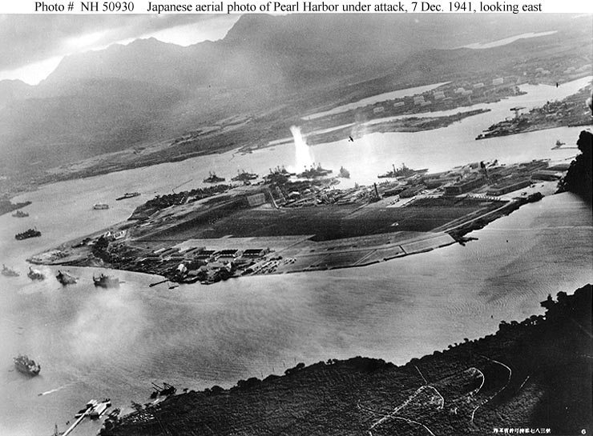

Slide 36
Pearl Harbor.
Devastating Attacks
Japan sinks four battleships and damages four others, sank three destroyers, damaged three light cruisers, destroyed 160 aircraft and damaged 128
2,400 American lives lost
Japan loses 29 planes
http://www.history.com/topics/pearl-harbor/videos#kenneth-m-taylor-at-pearl-harbor

Slide 37
Pearl Harbor..
Disaster for America
Boats and Planes had been parked closely together presenting excellent targets for Japanese Planes
America’s Pacific Fleet was crippled
Japan was unable to sink American Aircraft Carriers because they were not at Pearl Harbor
This saves Pearl Harbor from being a complete disaster

Slide 38
American Response
President Roosevelt calls emergency meeting of Congress
Day of Infamy Speech
http://www.history.com/topics/pearl-harbor/videos#attack-pearl-harbor
Asks Congress to declare war against Japan
Congress declares war

