Slide 1
Civil Rights
State Standards 9.7, 9.8, and 9.10

Slide 2
Civil Rights Movement
Beginnings in 1940’s
Goal
End Segregation in the South by staging various nonviolent protests
History of the civil rights movement is littered with incidents of injustice and violence

Slide 3
Lawful Segregation
Plessy v. Ferguson
Homer Plessy challenged the 1890 Louisiana Separate Car Act
Separate but equal railroad cars for blacks and whites
Plessy loses the case
Established the principle of “separate but equal”

Slide 4
Lawful Segregation.
Brown v. Board of Education
Stated segregated schools violated the 14th amendment
Supreme Court rules to end segregation in schools
Fighting Segregation
Sit-ins, marches, protests
Diane Nash
Leader who organizes lunch counter sit-ins in Nashville

Slide 5
School Desegregations
Clinton, Tennessee
1956
Clinton 12
12 African Americans who enroll in a previously all-white school after desegregation had been ordered
John Casper
White supremacist who organizes protests outside of the school
Beating of Clinton 12 bodyguard and school bombings

Slide 6
School Desegregations.
Little Rock, Arkansas
Central High School
Little Rock 9
African Americans who attend the High School
President Dwight D. Eisenhower sends the national guard to Arkansas to force the desegregation
James Meredith
Becomes the first African American to attend the University of Mississippi

Slide 7
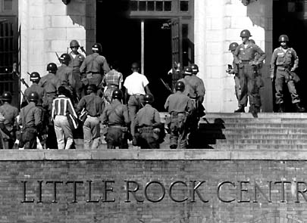

Slide 8
Rosa Parks
Challenging Plessy vs. Ferguson
Arrested for refusing to giver up her bus seat in Montgomery, Alabama to a white man at a time when African Americans were obligated to
Sparks a year long bus boycott
75% of the bus systems customers were African Americans
Struck deep into the city’s revenues
Boycott leads to desegregation of the bus system
Launches Dr. Martin Luther King Jr. to prominence

Slide 9
Filling the Jails
Southern Christian Leadership Conference (SCLC)
Along with MLK stage a campaign for desegregation in Birmingham Alabama
Participate in sit ins at libraries, kneel ins at churches, and boycotts of businesses
Many people arrested
MLK’s goal was to fill the jails through passive resistance

Slide 10
Children Protest
Children participate
High Power hoses and police dogs used against child protestors
Caused Americans to change their minds and pay attention to the movement
Results in Birmingham, Alabama being desegregated

Slide 11
March on Washington
“I have a dream”
Famous speech on the steps of the Lincoln Memorial
Lyndon B. Johnson
Signs the Civil Rights Act of 1964
Ends legal discrimination based on race
Also signs the Voting Rights Act of 1965
Allowed African Americans to vote

Slide 12
Landmark Cases
Gideon vs. Wainwright (1963)
Clarence Gideon arrested for burglarizing a poolroom
Couldn’t afford an attorney asks for one to be appointed for him
Court denies request, Gideon must serve as his own lawyer
Convicted and sentenced to five years
Petitions case because he had been denied counsel and due process guaranteed to him in the Constitution
Granted a new trial and found not guilty

Slide 13
Landmark Cases.
Miranda vs. Arizona (1963)
Ernesto Miranda arrested and identified as the assailant in a violent crime
Miranda questioned for two hours without being informed that he had the constitutional right to refuse to answer questions and the right to an attorney
Miranda convicted but appeals
Police had violated his 5th amendment, right against self incrimination
Miranda Warning, “You have the right to remain silent…”

Slide 14
Great Society
John F. Kennedy
November 22, 1963, Dallas, Texas
Kennedy shot in his car while he rides through the streets
Lee Harvey Oswald accused of assassination but never tried
Shot two days later by Jack Ruby
Huge conspiracy of who killed JFK
Grassy Knoll

Slide 15
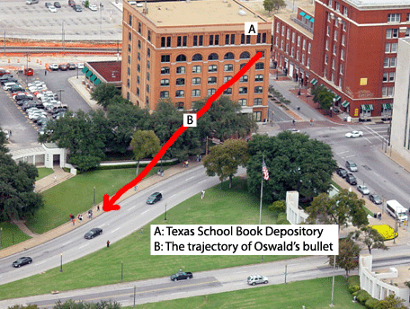
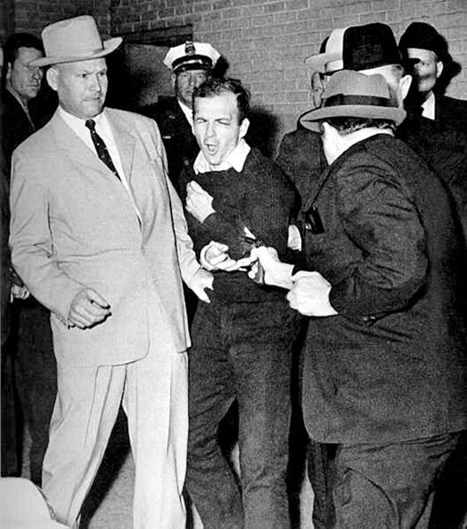
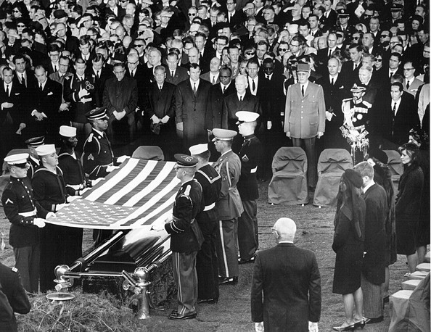

Slide 16
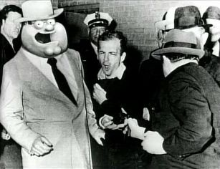
The Family Guy Version of Lee Harvey Oswald’s Death

Slide 17
Great Society
Lyndon B Johnson
Becomes President after Kennedy is assassinated
Introduces a series of reforms called The Great Society
Focus on helping those who lived below the poverty line
Head Start
Provides free preschool to children living in poverty
Medicaid
Provides medical care for individuals living in poverty
Medicare
Provides free hospitalization and inexpensive insurance for medical care for the elderly

Slide 18
Continued Upheaval
Civil Unrest
Riots break out across the country because of racial tensions
April 4, 1968
Dr. Martin Luther King Jr. shot
Shot in Memphis on the balcony of his hotel by James Earl Ray
King is buried in Atlanta, Georgia

Slide 19
Continued Upheaval.
1968 Election
Race for the Democratic Nomination
Hubert Humphrey, Eugene McCarthy, Robert Kennedy
Robert Kennedy assassinated on June 6, 1968
Dies from gunshot wounds
Sirhan Sirhan convicted of the assassination

Slide 20
Continued Upheaval..
1968 Democratic National Convention
Held in Chicago
Delegates nominate Hubert Humphrey to run for President
Outside thousands demonstrate against the Vietnam War
Chicago police unleash tear gas on crowd
Brings violence into American’s homes

Slide 21
Women’s Movement
Inspired by the Civil Rights movement
Second wave of “feminism”
Belief in the social, political, and economic equality of women
First wave of “feminism”
Considered to be the 100 year process of women achieving the right to vote

Slide 22
Women’s Movement.
The Feminine Mystique
Betty Friedan
Attempted to “define the problem that has no name”
Problem was that there was a sense that there is more to life than marriage and children
National Organization for Women (NOW)
Struggled to end the institutional discrimination of women in the workplace and education
Wanted to end stereotypes of women

Slide 23
Women’s Movement..
Gloria Steinem
Founder of Ms. Magazine
Challenged popular perceptions of women and brought awareness to the issues women were facing

Slide 24
Women’s Movement…
Equal Rights Amendment (ERA)
Prohibit legal discrimination based on gender
Passed the Senate but was not ratified by enough states
To this day there is no federal ERA
Some states have passed their own
Tennessee does not have one

