Slide 1
Economic Collapse
State Standards 7.7

Slide 2
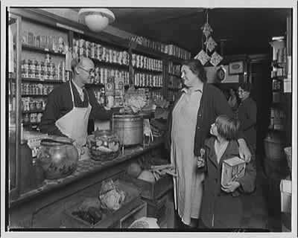
Rise of Consumer Culture
Consumer Culture
Fueled by mass production
Higher wages for workers meant more money to spend
Consumerism
Late 19th century
Department stores began to overwhelm consumers with product selection

Slide 3
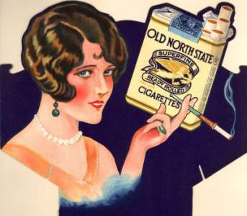
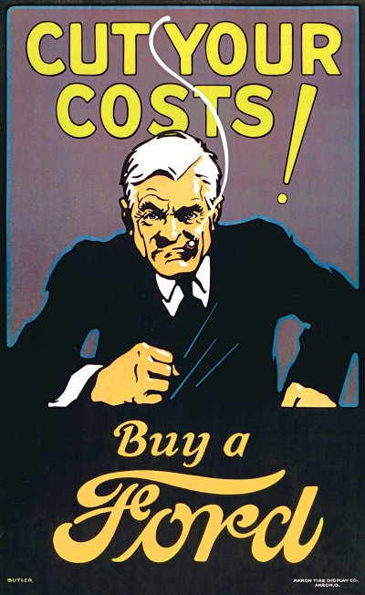
Consumer Culture.
Advertising
Marketing techniques grow
Show Windows and Catalogs
Creates new needs and desires in potential shoppers
New range of products also available
Americans began to spend more time and money on listening to radio programs and on movies with sound

Slide 4
Stocks and Credit
Investing
Thousands of individuals now have money to invest in the stock market
New investors bought stocks on Margin
Paying only a fraction of a stock’s worth with a promise to pay the rest once the stock was sold
Eventually caused the market values of all stocks to drop at the same time
Begins the slow downward slide

Slide 5
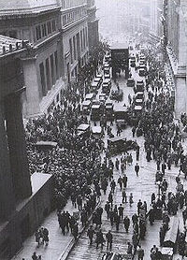
The Crash
Losing Value
Black Thursday
October 24, 1929
Stock market loses much of its value
Black Tuesday
October 29, 2929
Investors panicked as stocks continue to slide
Great Depression
By 1932 the ten year depression would be in full swing

Slide 6
Why Crash?
Why did the Stock Market Crash?
People had bought stocks on credit
When the stock market crashed the borrowers could not repay the banks the loans they had taken to buy the stocks
This is because they lost the money when the market crashed
Bank Crisis
People with money in banks realize the banks were in crisis
Rush to withdraw their funds
“Runs”
Almost completely destroyed the US banking system
2/5 of banks fail between 1929 and 1933

Slide 7
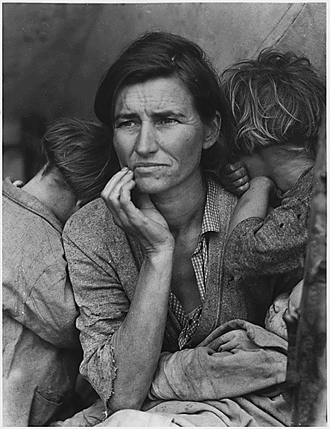
Fallout
Distrust in economy spreads like wildfire
Industries experience difficulty and resort to layoffs
Prices and income fall by as much as 50%
Debt remains at the same dollar amount

Slide 8
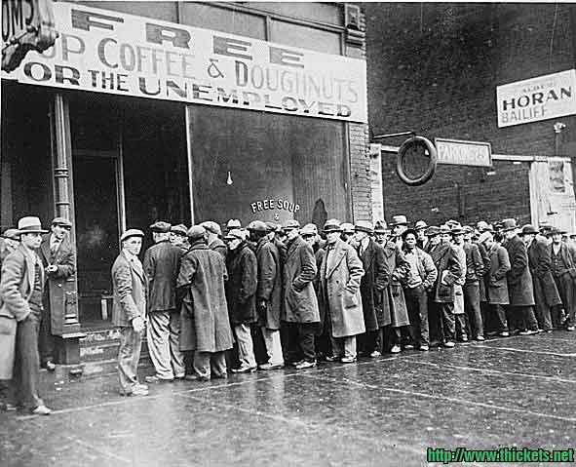
Fallout.
President Herbert Hoover
Hoover’s policies were not successful in renewing faith in the US economy or in providing jobs for unemployed
Criticized for believing the problem was temporary
Hoover wanted to let the States fix the problem instead of the federal government

Slide 9
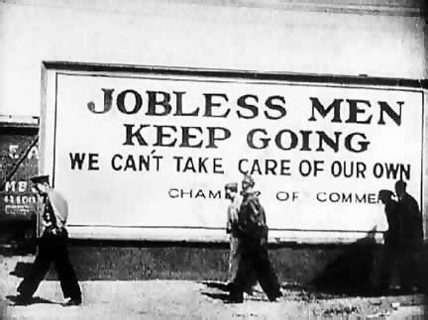
Fallout..
Smoot-Hawley Tariff Act of 1930
Two dozen economists urge President not to sign it
Hoover signs it anyways
The act established a high tax increase on imported goods that was almost quadruple the previous rate
Incited other countries to issue retaliatory rates
Nations worldwide turn to protectionists policies

Slide 10
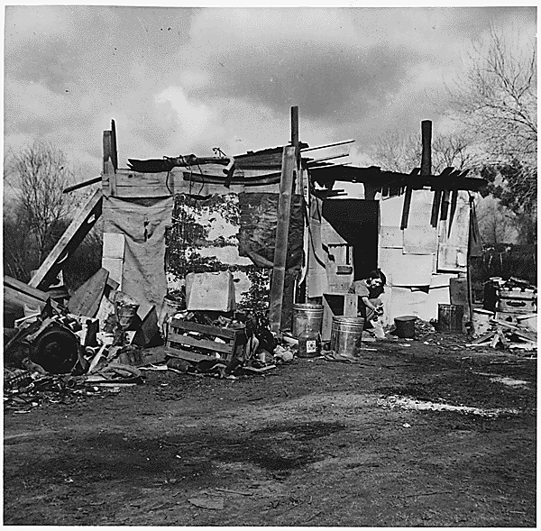
Fallout…
1929
¾ of Americans make less that $2,500 a year
Success achieved only through hard work and effort
Unemployment seen as a sign of poor character
Americans view government intervention as a sign of weakness of American spirit

Slide 11
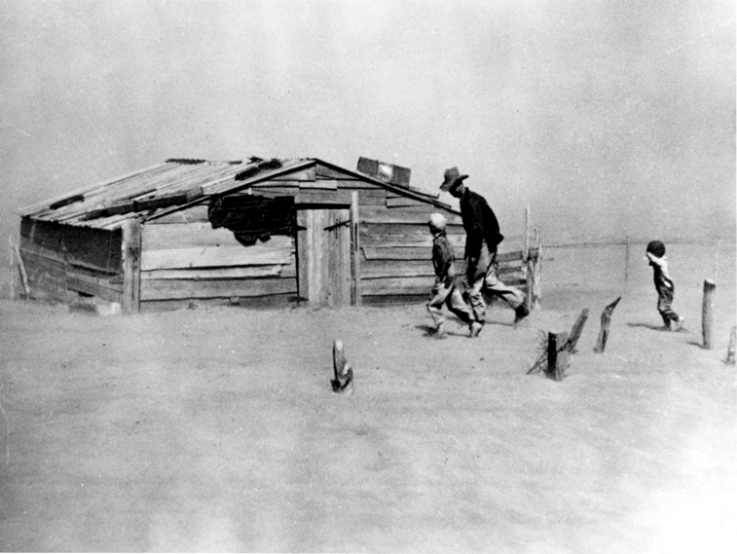
Rural Migration
Dust Bowl
Farmlands of prairie states
Crop prices drop, farmers plant more crops, fields were over planted
Causes the soil to erode and blow away
Draught causes huge dust storms to blow over the prairies

Slide 12
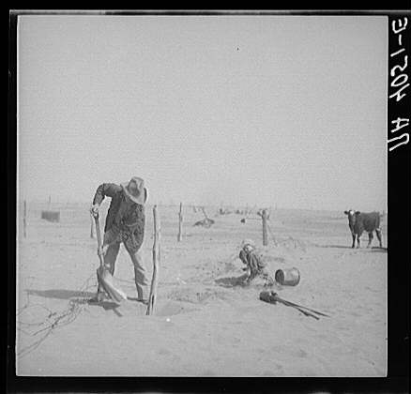
Rural Migration.
Migration
People begin moving to California
Few opportunities await families in California
Southerners move north to look for factory jobs
Many move to Detroit to work in auto industry
Most Americans move to cities because of the Great Depression

