Slide 1
Modern Politics
State Standards 10.2 and 10.4

Slide 2
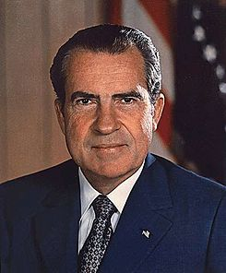
Ambitious Foreign Policy
Richard Nixon
Reaching beyond the Iron Curtain
  Visits Romania
  Visits Communist China
    Led to trade developing between the two countries
    Today China exports more goods to the US than any other country

Slide 3
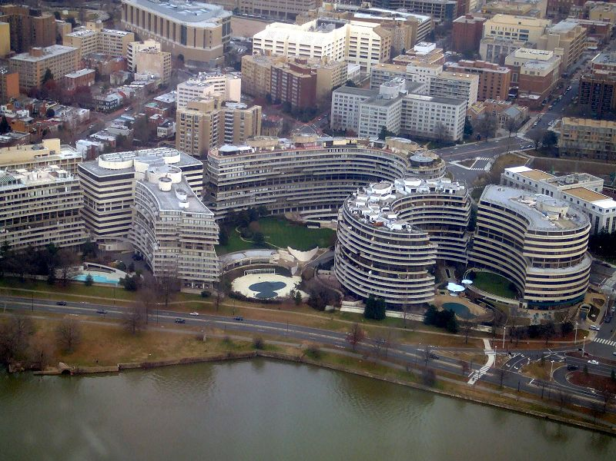
1972
Nixon runs for re-election
  Democratic National Committee’s office broken into
    DNC’s office located in the Watergate complex in Washington DC
    Senate begins investigating Nixon’s link to the break in
      Bob Woodward and Carl Bernstein from the Washington Post
        Journalists who used investigative journalism for the next two years

Slide 4
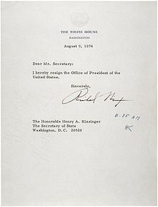
White House Tapes
Nixon Refuses
  Refuses to release White House tapes of conversations concerning Watergate
  Vice President Spiro Agnew
    Steps down from office when charged with taking bribes
    Gerald R Ford nominated as the new Vive President

Slide 5
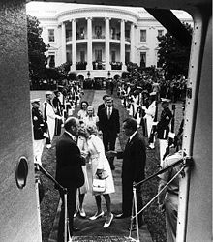
White House Tapes.
Nixon Releases the Secret Tapes
  Discovered that he had ordered a cover-up of the Watergate break-in
  Strong possibility of impeachment
    Nixon steps down as president on August 9, 1974
    Gerald Ford sworn in as the next president
      Ford pardons Nixon
        Controversial decision

Slide 6
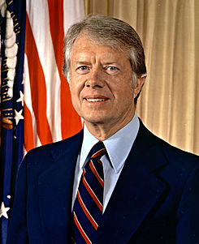
The Carter Administration
1976
  Jimmy Carter defeats Gerald Ford to become President
Carter Administration
  Based his foreign policy off of human rights
    Idea that the government should be protective of the civil rights of its citizens

Slide 7
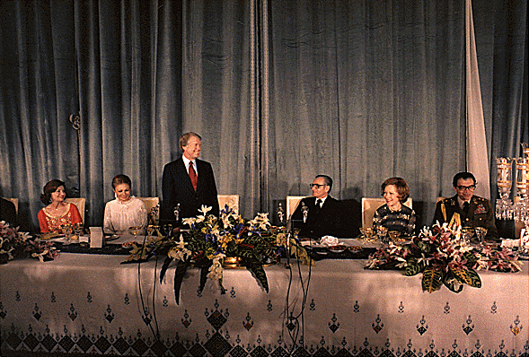
The Carter Administration.
Panama
  Carter signs two treaties with Panama
    Turned over the Panama Canal to Panama by 2000
Egypt and Israel
  Camp David Accords
    Peace treaty between Egypt and Israel that Carter helped arrange
    First treaty in history between Israel and an Arab country

Slide 8
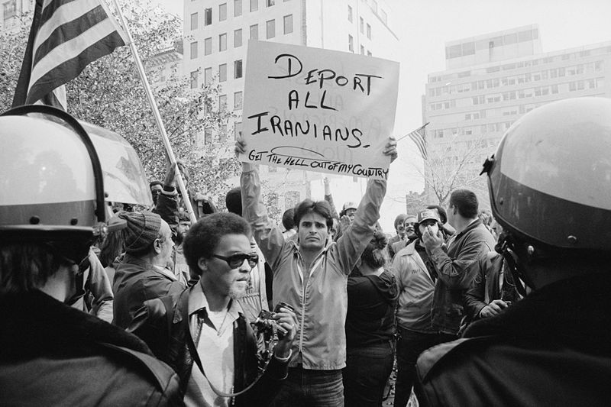
Iranian Crisis
1979
  Iranians storm the American embassy in Iran
    Take 66 Americans hostage
  Diplomatic attempts to free hostages fail
  Military rescue also fails
    Results in the death of eight American soldiers
  Iranian Crisis politically damages Carters administration
    Embarrassing for Carter
Iran releases the hostages the same day Carter leaves office

Slide 9
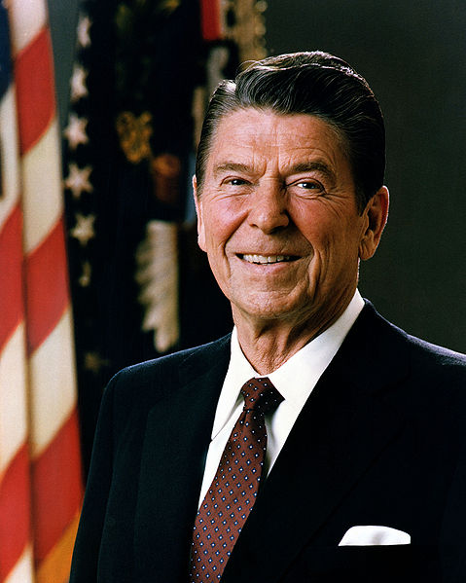
The Reagan Years
Ronal Reagan
  President from 1981-1989
  Called for a return to basic American values
    Emphasis on family life, patriotism, respect for law and order, and a reduction in the intrusion of the federal government into the lives of Americans
      Said the government collected too much taxes and spent too much on social programs

Slide 10
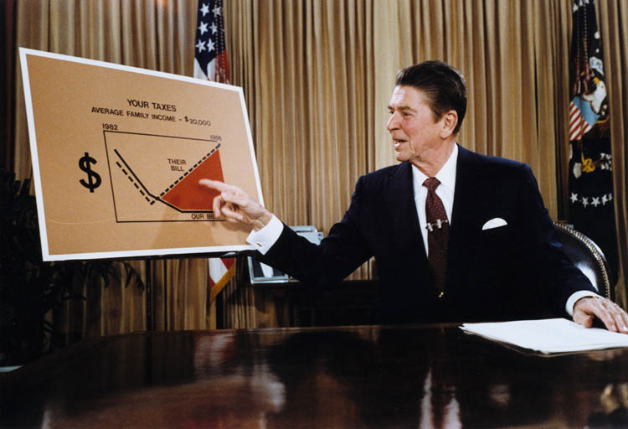
The Reagan Years.
Reaganomics
  Deregulation
    First step to deregulate the rules placed by government on American businesses
    Proposed reducing taxes on businesses and individuals to jumpstart the economy
      Critics predict Reaganomics will fail

Slide 11
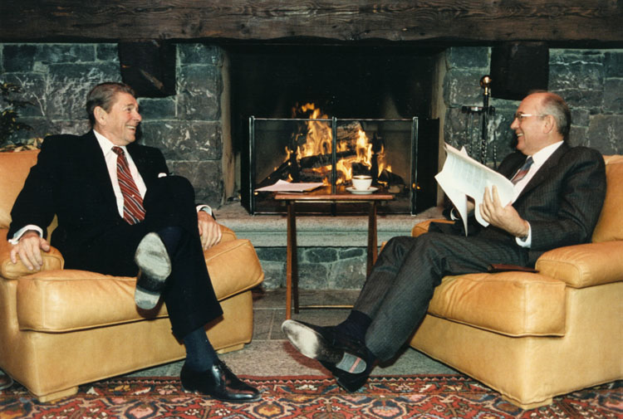
The Reagan Years..
Difficult Start
  Even though Reganomics struggled in the beginning, eventually businesses flourish
  Inflation tamed
  Tax decreases and spending on national defense push the National Debt to $3 trillion
    3,ooo,ooo,ooo,000

Slide 12
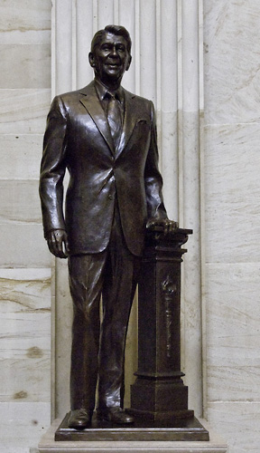
The Reagan Years…
Iran Contra Affair
  Oliver North and John Poindexter
    Members of the National Security Council
    Arranged for the sale of weapons to the Iranian government
      Did this to get Iran to release seven American hostages
  Funds from the sale of the weapons were diverted to “contras” (rebels) fighting against the Marxist government in Nicaragua
    Reagan never linked to the affair but was a major embarrassment

Slide 13
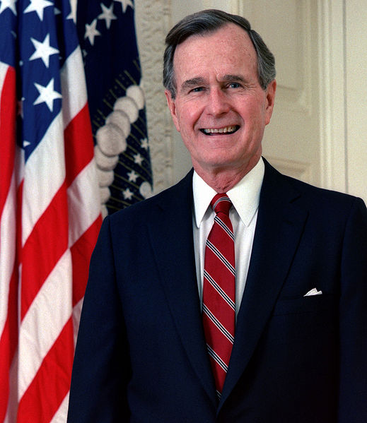
First Bush Administration
President George H. W. Bush
  1990
    Iraq invades Kuwait
    Protecting Oil interests
      President Bush sends troops to push Iraq out of Kuwait

Slide 14
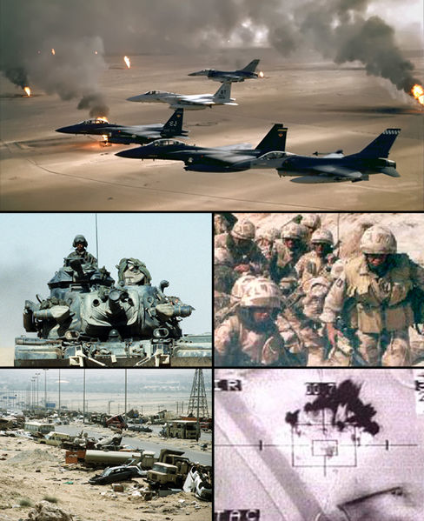
Operation Desert Storm
Desert Storm
  Also known as the First Persian Gulf War
  Swift war that left 150,000 Iraqi soldiers dead and destroyed all of Iraq’s military structure
  Sadaam Hussein

Slide 15
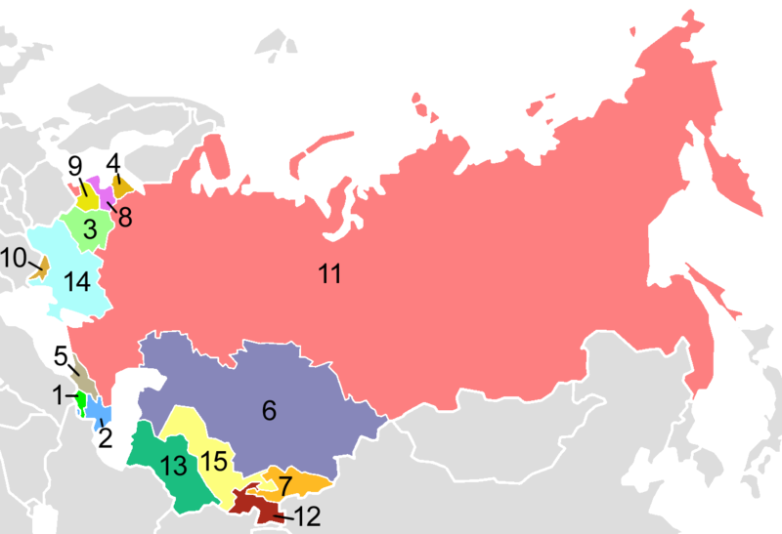
Soviet Union Collapse
1991
  Hardline Communist fail to overthrow the government
  15 republics who had been a part of the Soviet Union declare their independence
  Soviet flag lowered for the last time on December 25, 1991
    Cold War had come to an end

Slide 16
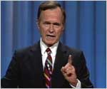
“Read my lips…No New Taxes”
Limited success for Bush domestically
  Economy declines
  Bush forced to raise taxes
    During his campaign he had promised “Read my lips…no new taxes”

Slide 17
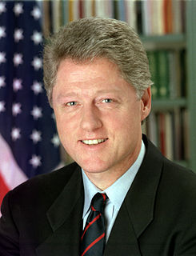
The Clinton Years
President Bill Clinton
  His campaign brings together Democrats
  Wins election of 1992
    Focuses on social policy
    Rough start for Clinton

Slide 18
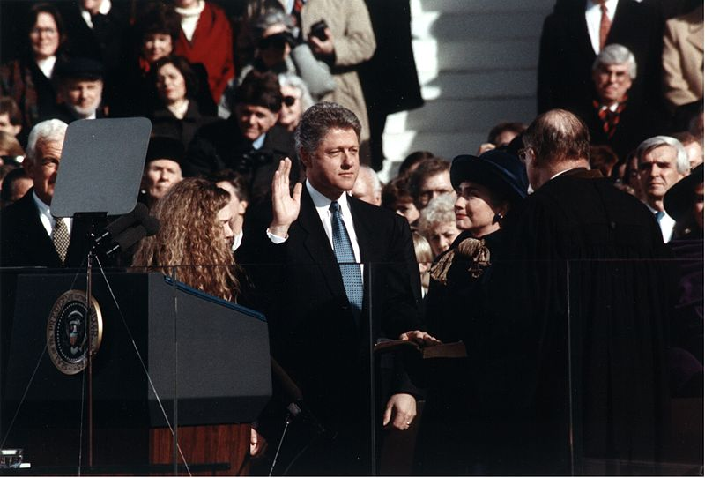
The Clinton Years.
Economy Booms Again
  1993 North American Free Trade Agreement (NAFTA)
    US, Canada, and Mexico
    Eliminated all trade barriers among the three countries
      Opponents predict a loss of American jobs
      Supporters believe NAFTA would expand consumer markets

Slide 19
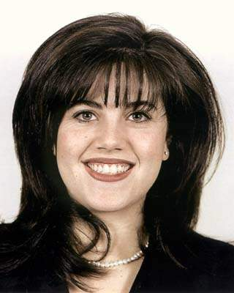
The Clinton Years..
Monica Lewinsky
  White House intern
  Clinton had testified under oath about his relationship with Lewinsky
    Clinton accused of perjury, lying under oath

Slide 20
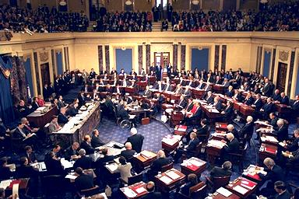
The Clinton Years…
Impeachment?
  Articles of impeachment voted on by Congress
  February 12, 1999
    Senate acquits Clinton of wrongdoing while in office
    Allows him to remain President

