Slide 1
Politics and Corruption
State Standards 6.10 and 6.11

Slide 2
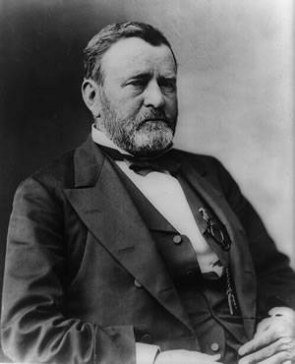
Black Friday of 1869
First of three scandals under President Grant
Gold Exchange
Gold was a commodity that was traded and sold on the market
James Fisk and Jay Gould
Purchased enough gold so they could manipulate its price on the stock market
If they could control the price of gold they could earn higher profits for themselves

Slide 3
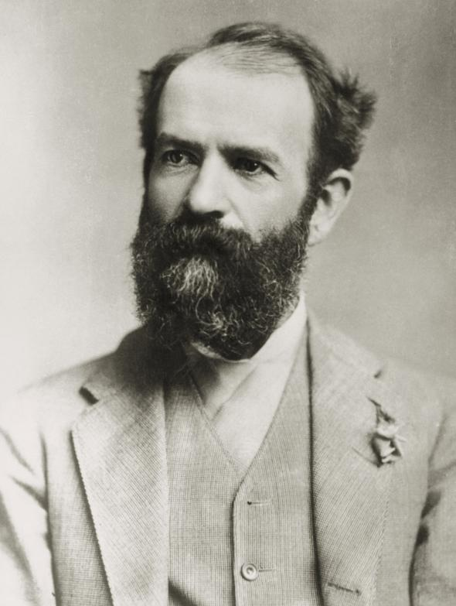
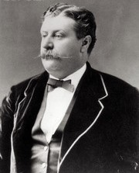
Black Friday of 1869.
Fisk and Gould’s friend
Befriended Abel Corbin, President Grant’s brother in law
Used Corbin to convince President Grant to refrain from selling government gold
This would lower the worth of the gold they purchased
Grant learns of the plot
Ordered the sale of 4 million dollars of government gold

Slide 4
Black Friday of 1869..
Because Grant decides to sale so much gold so quickly he caused a minor panic
Black Friday of 1869
Panic happened investors had purchased gold on loans
When the price of gold dropped they were unable to repay the loans

Slide 5
Credit Mobilier Scandal
Second of three scandals under President Grant
Union Pacific Railroad was a private company that received government assistance to build the transcontinental railroad
Credit Mobilier was a company set up to contain the profits
Congressmen and Vice President given stock in Credit Mobilier in exchange for favors
Congressional Investigation followed and as a result some congressional representatives were censured

Slide 6
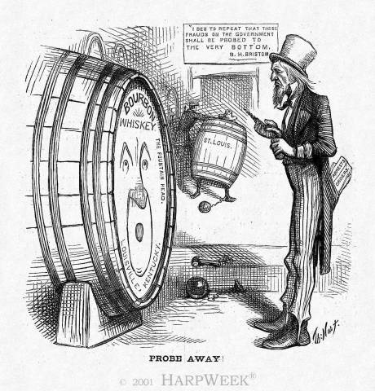
Whiskey Ring
Third of three scandals under Grant
Whiskey was taxed heavily by the federal government
Distillers wanted more of the profit from these taxes
Bribery rings develop where Distillers bribed politicians so that they did not have to pay the taxes
Secretary of Treasury Benjamin H Bristow
Broke the Whiskey Ring
Results in the indictments of over 200 people

Slide 7
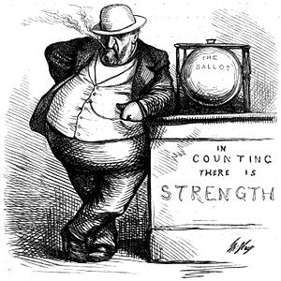
Tammany Hall
More widespread corruption
Tammany Hall
Political organization in New York City
Political Machine that practiced “machine” politics
Bosses
Networks of local leaders, called bosses, helped communities get things they needed
People responded to this help with votes
Used the growing immigrant population to gain even more votes

Slide 8
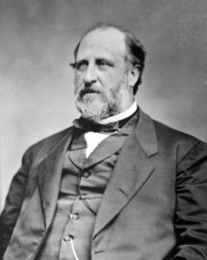
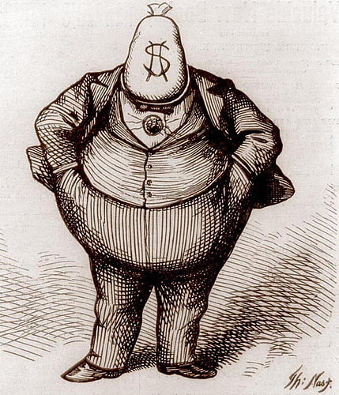
Tammany Hall.
Boss William Marcy Tweed
Created a huge network for Tammany Hall
Defrauded the city of millions of dollars by creating companies to help the city and overcharging the city and keeping the profits
Sent to jail in 1871 for defrauding the city

Slide 9
Compromise of 1877
1876 Presidential Election
Won by Rutherford B. Hayes
South wanted Samuel J. Tilden to win and were upset when he lost
In order to please the North and South the Compromise of 1877 was created
Established Rutherford B. Hayes as president
Ended Reconstruction in the South
Federal troops were withdrawn from the South

Slide 10
Garfield’s Assassination
Rutherford B. Hays promises he would only serve one term
James Garfield wins the next election
Garfield
Wins a battle against Roscoe Conkling over patronage issues
A system for appointing political supporters to government jobs

Slide 11
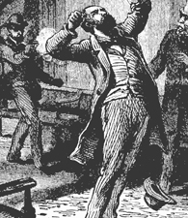
Garfield’s Assassination.
Charles Guiteau
Disgruntled office seeker who did not receive an appointment to office by Garfield
Shot President Garfield
Resulted in a sever infection that killed Garfield 80 days later

Slide 12
Civil Service Reform
Chester Arthur
Becomes President after Garfield dies
Beneficiary of the Spoils System
Awarded civil service, or government, jobs to political allies who may or may not have been qualified for that position
Even though President Arthur was a beneficiary of the system he knew the nation did not approve
Pendleton Act
Established a Civil Service Commission which created a required examination for federal jobs
Fewer jobs were handed out as political favors

Slide 13
Granger Laws
Granger Movement
Consisted of a coalition of US farmers that fought corporate monopolies in the 1870’s
Price Fixing
Occurs when businesses or owners conspire to raise prices on goods and services
Granger Laws
Passed to regulate businesses, proved the farmers did have political power

Slide 14
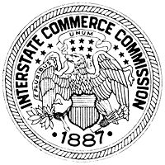
Interstate Commerce Act
Interstate Commerce Act
Required that railroads establish “reasonable and just” rates for consumers
Established the Interstate Commerce Commission
US Government’s first regulatory agency

