Slide 1
Post-War Culture
State Standards 9.2, 9.4, 9.12, 9.13

Slide 2
New Domesticity
Time of change and return to normalcy
Television
TV Dinners
Box Cakes
Life in the suburbs
All of this fueled by renewed consumerism
US gears down its war production

Slide 3
New Domesticity.
Baby Boom
When the great generation returns home a baby boom results
Increased the population by 20%
Search for the American Dream
Came to include a family with a house in the suburbs
Cookie Cutter homes

Slide 4
New Media
Changing Lifestyles
Americans stay home to watch television instead of going out
In a ten year span the amount of households with a TV increases by 41 million

Slide 5
New Media.
1960 Presidential Election
John F. Kennedy vs. Richard M. Nixon
Television brings the candidates into American homes
Televised Presidential Debates
70 million viewers watch
Nixon looks worn, sickly, and tired next to the young and tan Kennedy

Slide 6
New Media..
1960 Presidential Election
Radio listeners to the debate claimed Nixon won
Television viewers claimed Kennedy won
50% of voters in the election say the televised debate influenced their decision on voting day
Politicians take notice
Kennedy wins

Slide 7
New Media…
Martin Luther King Jr.
1963 protest against Jim Crow laws in Birmingham, Alabama
TV shows images of police dogs and powerful fire hoses being used against demonstrators
The Country is appalled!

Slide 8
Tennessee and the Music Industry
Nashville and the Grand Ole Opry
Tennesse popularizes country music on a national scale through the Grand Ole Opry
Radio program broadcast on Nashville’s WSM radio
Ralph Emery
DJ who helped make the Opry the longest running radio program in history

Slide 9
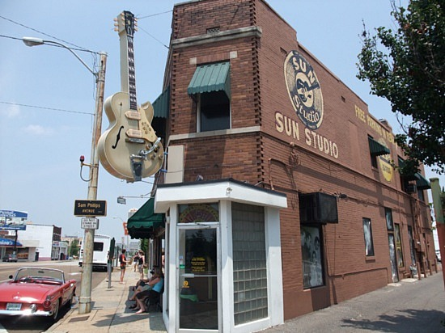
Tennessee and the Music Industry
Memphis
Sun Studios and Stax Records
Elvis Presley
Records rock n’ roll at Sun Studios
Otis Redding
Music featured on Stax Records which helped expose soul music and make it popular

Slide 10
Expanding Horizons
Federal Postwar Initiatives
Americans given opportunities to better their lives
GI Bill
Paid tuition for servicemen after the war who wanted to go to college
National Interstate and Defense Highway Act
Created a nationwide system of highways that allowed for easier and more extended travel
Also aids in the suburbanization of America
Americans travel the roads, sightseeing spots, love affair with cars

Slide 11
Segregation Continues
African Americans continue moving north
White Americans move to suburbs
African Americans move to the inner city

Slide 12
Segregation Continues.
Jim Crow Laws
Laws based off of the mandate of “Separate but equal”
Separate But Equal
African Americans were supposed to have the same as whites but just separated
Under Separate but Equal African Americans did not enjoy the same living standard, education, career opportunities, public access, or facilities as whites did
Poll Taxes and Literacy tests used to keep African Americans from voting

Slide 13
Changing Gender Roles
Women and the Workforce
After WWII women were expected to leave the workforce and return home
Average marrying age of women drops to 20 years
40% of already working women remained in the workforce
Relegated to what was seen as a woman’s job
Women do not earn as much as men do for the same job

Slide 14
Changing Gender Roles.
Stereotypical Female Assets
Clean House
Neat Appearance
Well behaved children
The ideal woman was portrayed in television sitcoms and through advertising
Rise of dissatisfaction
Women feel dissatisfied, eventually leads to the 1960’s women’s movement

Slide 15
The Space Race
Sputnik I
Russians launch the first satellite into orbit
US begins to feel like far less of a super power
President Dwight D. Eisenhower
Blamed for the US not being as technologically advanced as Russia
Worries about the military implications of Sputnik I

Slide 16
The Space Race.
Explorer I
US launches its first satellite
National Aeronautics and Space Act (NASA)
Goal was for the US to become a leader in space exploration
Public schools put more emphasis on math and science

Slide 17
The Space Race..
Television and the Space Race
TV brings the Space Race into American’s homes
Neil Armstrong
First man on the moon
Apollo 11
July 20, 1969
“One small step for man, one giant leap for mankind”

Slide 18
Educational Changes
Revamp Public Schools
Rudolph Flesch, Arthur Bestor, Robert Hutchins
Sought to revamp public schools and university curricula to improve education
Curricula geared toward the most outstanding students in hopes of grooming them for important government jobs

