Slide 1
The Cold War
State Standards 9.1, 9.3, 9.5, 9.6, and 9.9

Slide 2
Communist Expansion
End of World War II
Economies of most European countries in ruin
Disagreement between Allied nations over Communist Expansion

Slide 3
Cold War
Struggle for power
United States vs. the Soviet Union
1945-1991
“Cold”
Instead of direct warfare the US and the Soviet Union funded armed conflicts around the world between Communist and non-Communist governments
Democracy vs. Communism

Slide 4
Promoting Democracy
Soviet Union on the move
Estonia, Latvia, and Lithuania annexed by Soviet Union
Poland, Romania, Bulgaria Yugoslavia, Hungary, Czechoslovakia, and Albania become Soviet satellites
US fears further Soviet expansion

Slide 5
Promoting Democracy.
Iron Curtain
Symbolic of the political division between Western and Easter Europe
Winston Churchill warns that an iron curtain has extended across the continent
Was referring to the spread of Communism

Slide 6
Promoting Democracy..
Iron Curtain
Policy of Containment
George F Kennan
Provide economic support and military aid to vulnerable countries to prevent the spread of Communism
Becomes known as the Truman Doctrine

Slide 7
The Marshall Plan
Secretary of State George Marshall
Proposed a relief plan to provide funds to Western European countries
These funds were to be used to buy supplies with which to rebuild their economies
Allowed Western Europe to rebuild itself and helped stop the spread of Communism

Slide 8
North Atlantic Treaty Organization
NATO
Created in 1949 in response to fear that the Soviet Union would attack Western Europe
12 members join
US, France, Britain, Belgium
Defensive Alliance

Slide 9
The Warsaw Pact
1955
Created in response to NATO
Mutual defense agreement among Communist countries in Eastern Europe

Slide 10
Post WWII Germany
Post World War II
Germany divided into four zones by the Allies
Each of the Allies controls one zone
Berlin
Surrounded by the Soviet Union’s zone and was divided also into four sections
Zones controlled by Britain, US, France, and Soviet Union

Slide 11
Berlin Blockade and Airlift
Changes
France, US, and Britain join their zones together
Soviet Union views this as a threat
Sets up the Berlin Blockade between Berlin and West Germany
Blockade
Isolation of an area, often by force, in order to prevent the entrance and exit of traffic and trade

Slide 12
Berlin Blockade and Airlift.
Response
US and Britain supply Berlin with food and other supplies
Did this by military air transport and airlifting out West Berlin exports
Showed the Soviet Union that the US would not give up on Berlin

Slide 13
Berlin Wall
Fleeing Communism
People were fleeing Communist controlled East Germany through the streets of Berlin
Border was still open at this point
To stop the defections the Communist build a wall to divide Berlin
Berlin Wall
Physical barrier that isolated West Berlin from the rest of Germany

Slide 14
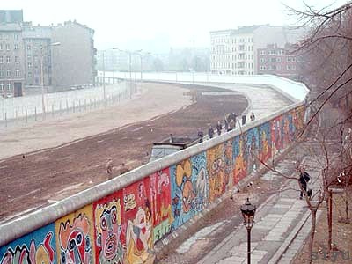
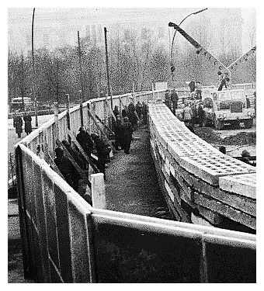
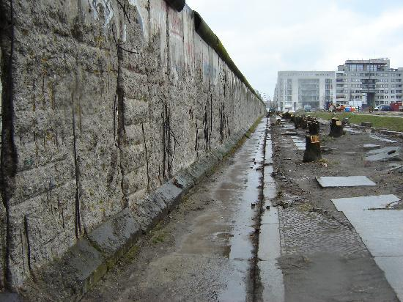
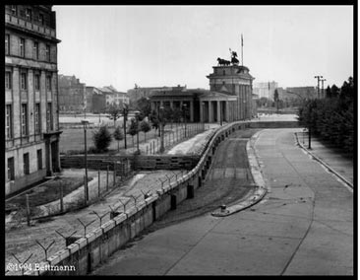

Slide 15
Arms Race
Atomic Weapons
Scientists had hoped that the Atomic Bomb would force the hand of diplomacy because of its horrific potential
Instead a struggle between the two world superpowers begins

Slide 16
Arms Race.
Mao Zedong
Leads a Communist take over in China
Domino Theory
US believes that if one country, such as China, becomes Communist then more countries will follow
To stop the dominos from falling the US fights two wars
Korean War
Vietnam War

Slide 17
Korean War
Korea
Japan controlled Korea during World War II
Soviet Union and US take control of Korea post WWII
Korea split into two along the 38th Parallel
Divided the country into Communist North and Democratic South

Slide 18
Korean War.
North invades South
1950
US backs South Korea
Soviet Union and China back North Korea

Slide 19
Korean War..
Mobile Warfare
North Korea almost forces the US off of the peninsula
Douglas MacArthur leads the US
Pushes the Communist all the way back to China
Wants to use the atomic bomb against China
Relieved of his command by President Truman
China comes to the aid of North Korea

Slide 20
Korean War…
Trench Warfare
China pushes the US back to the 38th Parallel
Trench Warfare develops
Stalemate
War lasts three years
Ends in a stalemate with neither side gaining territory
Peace treaty was never signed to end the war

Slide 21
McCarthyism
Joseph McCarthy
Crusade against suspected Communists led by McCarthy
House Un-American Activities Committee (HUAC)
Used to accuse individuals of all professions of Communist affiliation
Accuses politicans and movie stars
Many entertainers blacklisted because of McCarthyism

Slide 22
Cuba
Fidel Castro
Overthrows the government in Cuba in 1959
Castro turns to Communism in Cuba
Becomes the first Soviet backed country in the Western Hemisphere

Slide 23
Bay of Pigs
Invasion
US sponsors an invasion of Cuba by Cubans who had fled the country and living in the US
Invaded at the Bay of Pigs
Failed and was an embarrassment for President John F. Kennedy

Slide 24
Cuban Missile Crisis
Soviets have no missiles that can reach the US
Soviets install missiles on Cuba that can reach the US
US responds with a naval blockade of Cuba
US and Soviet Union almost go to war
After tense negotiations Soviets removed missiles and the US Navy withdraws
Fear of nuclear attack always present

