Slide 1
The Great Depression
State Standards 8.2 and 8.4

Slide 2
Economic Cycle
Economic Downturns
Occur when there is a shock to the economic system
Aggregate Demand curve shifts left
Consumers are not willing to buy as much at any given price
In an individual market this would be easy to fix, simply lower prices to increase demand
However, when demand falls for everything it is not easy for all producers to lower their prices

Slide 3
Economic Cycle.
Economic Downturns
Since not as much is being sold producers look to lower their costs
To do this they produce less
This requires fewer workers (Unemployment increases)
Also decreases the GDP (Gross Domestic Product)

Slide 4
Economic Cycle..
GDP
Gross Domestic Product
The total market values of goods and services produced by workers and capital within a nation's borders during a given period
If GDP declines for six months then there is a recession
If a recession lasts for a while and the decrease in a GDP is enough then the downturn is called a depression

Slide 5
Effects
1932
24% of all Americans are unemployed
1930’s averaged an 18% unemployment rate
People do whatever they have to do to survive
Turn off electricity, live on eggs, sell apples on the street, lived with relatives, lived in shacks, lived in abandoned cars

Slide 6
Effects..
Farmers
Unable to make payments due on their buildings and equipment
Default on loans and lose their land
1929-2932
¾ of rural banks close
Leaves farmers with no way to borrow money

Slide 7
Effects.
Shantytowns
Places where thousands of people lived in shacks and tents
Many Americans blamed President Hoover for these conditions
Shantytowns became known as “Hoovervilles”

Slide 8
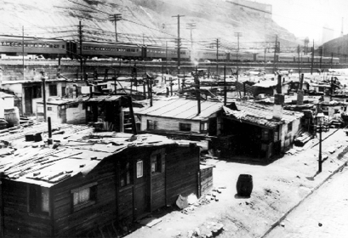
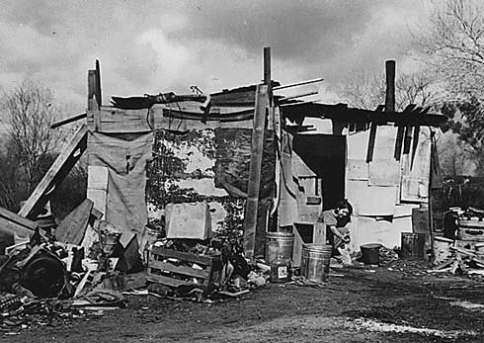
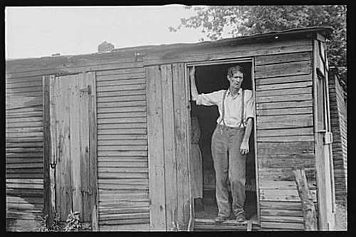

Slide 9
Effects..
Breadlines
Americans begin to rely on the government for food
Breadlines develop
Men would stand in lines for hours to be given bread with which to feed their families

Slide 10
Bonus Army
Bonus Army
Made up of unemployed World War I veterans
In 1932 they marched on Washington D.C. and occupied empty buildings in the city
Protesting the government’s inability to pay them their bonus money
Veterans wanted their money sooner than the pay date

Slide 11
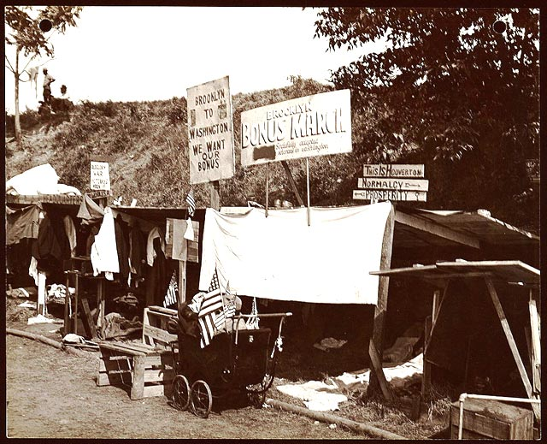

Slide 12
Bonus Army.
End of the army
Government cannot pay the money because it is dealing with the Great Depression
Government orders US Army to deal with Bonus Army
US Army storms the Bonus Army's buildings and shantytowns
Results in casualties and the dispersal of the veterans
Criticized for using excessive force against US Veterans

Slide 13
Religious Revivalism
The South in the 1920’s
1925
Tennessee prohibits teaching theories contrary to the Biblical concept of creation
Aimed at Charles Darwin’s theory of evolution

Slide 14
Creation vs. Evolution
Teaching Darwinism
John Scopes, high school biology teacher, charged with teaching evolution
Clarence Darrow, Scope’s lawyer argued that the Tennessee law violated the separation of church and state by taking a religious position
William Jennings Bryan
Argued against Darrow
Bryan wins the trial
Scopes eventually let off by the State Supreme Court because of a technicality

Slide 15
Election of 1932
Hoover vs. Franklin D. Roosevelt
Roosevelt blamed Hoover for the Great Depression
Roosevelt wins a landslide victory
Won by 20% of popular vote
472 electoral votes to 59
“This great Nation will endure as it has endured, will revive and will prosper. So first of all, let me assert my firm belief that the only thing we have to fear is fear itself”

Slide 16
Election of 1932.
Roosevelt
Vowed to “put people to work”
Promised “strict supervision of all banks”
Closed all banks nationwide for four days
Only certain banks that passed qualifications were allowed to reopen
Roosevelt told Americans that the new banks were “safer to keep your money in a reopened bank than under the mattress
Roosevelt Promises a “New Deal” for American people

