Slide 1
The New Deal
State Standards 8.6, 8.9, and 8.11

Slide 2
First 100 Days
The New Deal
Roosevelt elected in 1932
Offered hope to the unemployed with experimental programs
Aimed to put money back into Americans’ pockets
Using the New Deal Roosevelt enacts many new programs within the first 100 days of becoming President
Roosevelt wanted to put people back to work, this would put money in their pockets, which they would spend, this spending would stimulate the economy

Slide 3
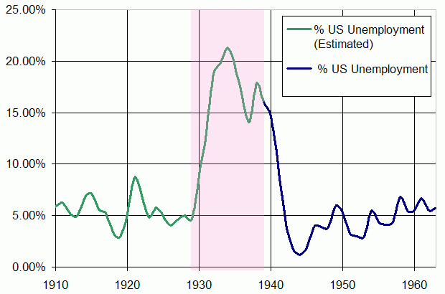

Slide 4
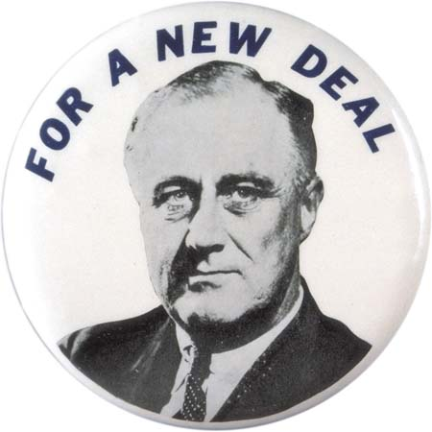
Banking Reforms of 1933
Mandatory Holiday
Roosevelt places all of the nations banks on a mandatory holiday
So that their financial status could be inspected
Banks needed government approval to reopen

Slide 5
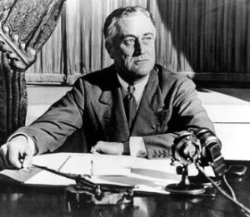
Banking Reforms of 1933
Emergency Banking Relief Bill
Designed to reorganize banks that were in financial trouble
Aimed to restore the publics’ faith in banks

Slide 6
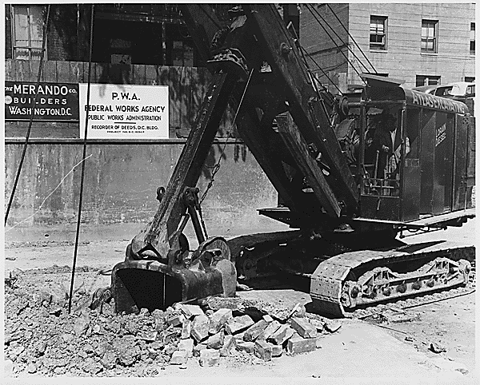
Work Programs
Putting people to work
Public Works Administration (PWA)
Funded the construction of three billion dollars worth of public works
Dams, airports, schools, bridges
Created a need for workers

Slide 7
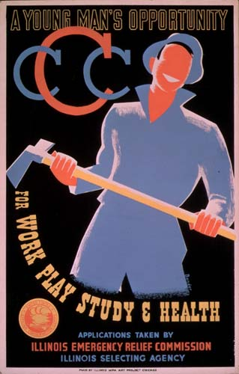
Work Programs.
Putting People to Work
Civilian Conservation Corps (CCC)
Hired single, unemployed men between the ages of eighteen and twenty-five
Paid $30 a month
Housed in camps
Worked on reforestation, flood control projects, built and maintained state and national parks
Employs over three million men

Slide 8
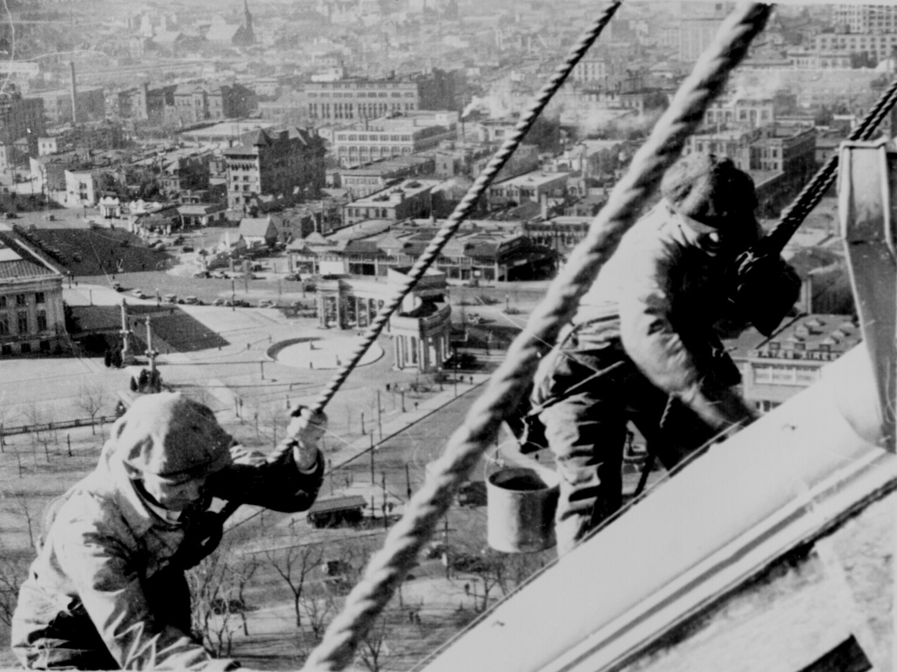
Work Programs..
Federal Emergency Relief Administration (FERA)
Funded state and local projects
Employs over 20 million people
Civil Works Administration (CWA)
Short term public works program that gave jobs to the unemployed
Rebuilt railroads, airports, and national parks
Employs four million Americans

Slide 9
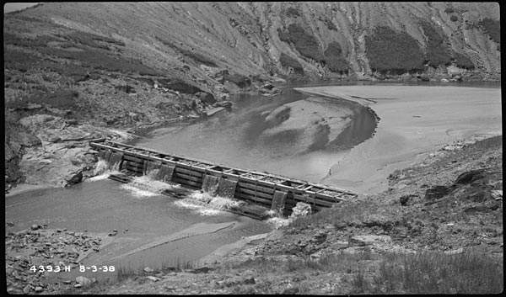
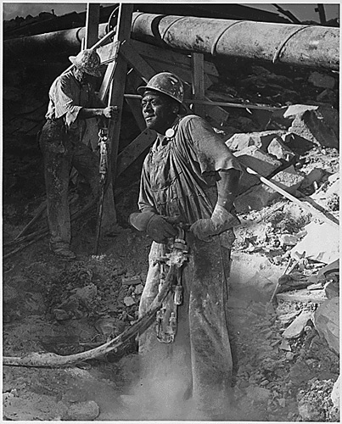
Work Programs…
Tennessee Valley Authority (TVA)
Provided federally owned electricity to local entities in six states
Oversee the control of floods, navigation, and related aspects of national defense
Still functions today

Slide 10
Work Programs….
Agricultural Adjustment Administration (AAA)
Helped raise crop prices by paying a subsidy to farmers
Subsidy
Money paid by the government for a certain purpose
Goal
To prevent crop surpluses and keep farmers from overplanting to prevent another Dust Bowl

Slide 11
Work Programs…..
National Industrial Recovery Act (NIRA)
Called for industrial regulation and the establishment of fair competition codes for various industries
Protect consumers, employers, and employees
National Recovery Administration
Created over 500 codes of fair practice for industry
Allowed workers to unionize
Eventually found unconstitutional

Slide 12
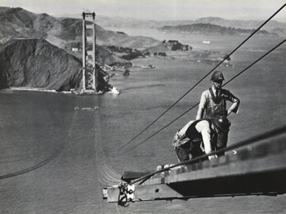
Work Programs……
Works Progress Administration (WPA)
Built buildings, bridges, and roads
Golden Gate Bridge in San Francisco
Creates 8.5 million jobs

Slide 13
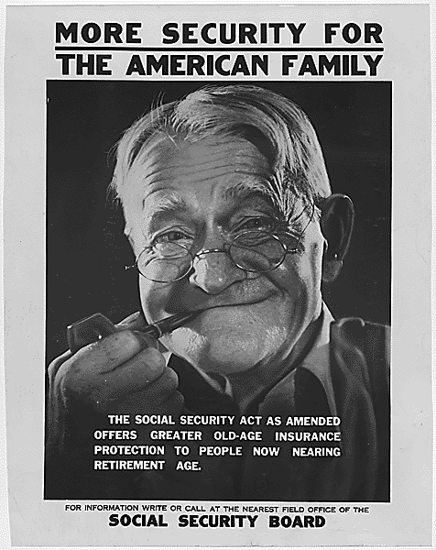
Work Programs…….
Social Security Act (SSA)
Cooperative federal and state program of unemployment compensation
Federal program of retirement insurance when workers reach the age of 65
Money accumulated for plan by payroll taxes of 1%

Slide 14
Work Programs……..
Federal Deposit Insurance Corporation (FDIC)
Insured savings accounts in banks approved by the government

Slide 15
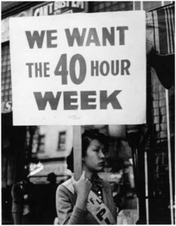
Work Programs………
Fair Labor Standards Act (FLSA)
Established minimum wages and maximum hours for businesses engaged in interstate commerce

Slide 16
New Deal Haters
Supreme Court
AAA deemed unconstitutional
NIRA deemed unconstitutional
Pending Cases against the Social Security Act and the TVA
Roosevelt needs a solution to keep these acts from being thrown out

Slide 17
New Deal Haters.
Roosevelt’s Proposal
“Packing the Court”
Roosevelt proposes a plan to increase the number of justices on the supreme court from nine to fifteen
Roosevelt would then fill the Supreme Court with his supporters
Supreme Court lays off of the New Deal because of this threat

Slide 18
New Deal Haters..
Big Business
Believed government interference in business was unwise
Helped challenge the constitutionality of some Acts

Slide 19
In Your Face!
By 1939 Roosevelt’s programs had stabilized the economy
Strikes were limited because labor unions and businesses cooperated
Growing international tensions grab America’s attention
World War II would help Roosevelt finish off the defeating the Great Depression
Roosevelt’s massive spending had helped stabilize the economy but World War II would end the Depression

