Slide 1
The Roaring Twenties
State Standards 7.5

Slide 2
Mass Production
Growing Consumer Demands
Desire for normalcy after World War I led to an increase in sales and production
The Assembly Line
Designed by Henry Ford in 1913
Driving force behind growing consumer demands

Slide 3
Mass Production.
Henry Ford
Goal was to create a mass production process that was so efficient that the product would become more affordable to many more consumers
Had to improve the processes efficiency
More had to be made for less

Slide 4
Mass Production..
Assembly Line
Workers trained in and performed specific tasks
Done in an industrial rhythm of skill and timing
Mass production creates a hierarchy in the workplace
Need for supervisors and managers

Slide 5
Mass Production…
Model T
By 1924 Henry Ford’s Model T sold for under $300
Much more affordable to the everyday person who made $1,300 annually
Wages
Henry Ford increases his workers’ wages to $5 a day
Gives his workers more money to spend

Slide 6
The Roaring Twenties
Recreational Time
Labor saving devices lead to more free time
Because of this an economic boom developed
The Roaring Twenties

Slide 7
Temperance Movement
Temperance Movement
Led largely by Progressives
Pushed to make alcohol illegal
1919
18th Amendment
Sale of alcohol prohibited

Slide 8
Temperance Movement.
National Prohibition Act
Provided for the enforcement of the 18th amendment
Called Prohibition
Prohibited the manufacture, sale, and distribution of alcohol
Drinking alcohol was legal

Slide 9
Temperance Movement..
Speakeasies
Illegal clubs where alcohol was available
Bootleggers supplied the speakeasies with alcohol
Bootleggers often linked to the Mafia
Rises to power in Chicago and New York
Bootleggers give rise to NASCAR

Slide 10
Birth Control
Comstock Laws
Made it illegal to send lewd materials through the mail
Birth Control considered lewd and illegal
Margaret Sanger
Felt unplanned pregnancies were a shackle to women
Was a pioneer in the American birth control movement
Sent pamphlets about birth control in the mail
Arrested when she opened up a birth control clinic

Slide 11
The Jazz Age
Jazz
A new energetic music that reflected the restless spirit of the 1920’s
Phonograph Records and Radios spread the new music
Jazz has its roots in the music made on plantations in the South
Was further developed by New Orleans musicians in the 20th Century

Slide 12
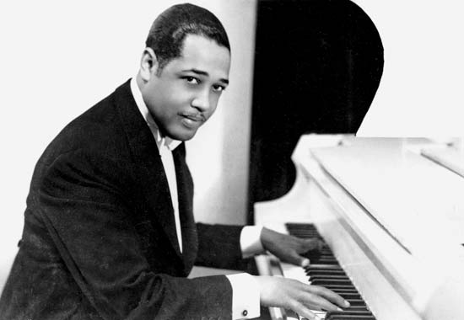
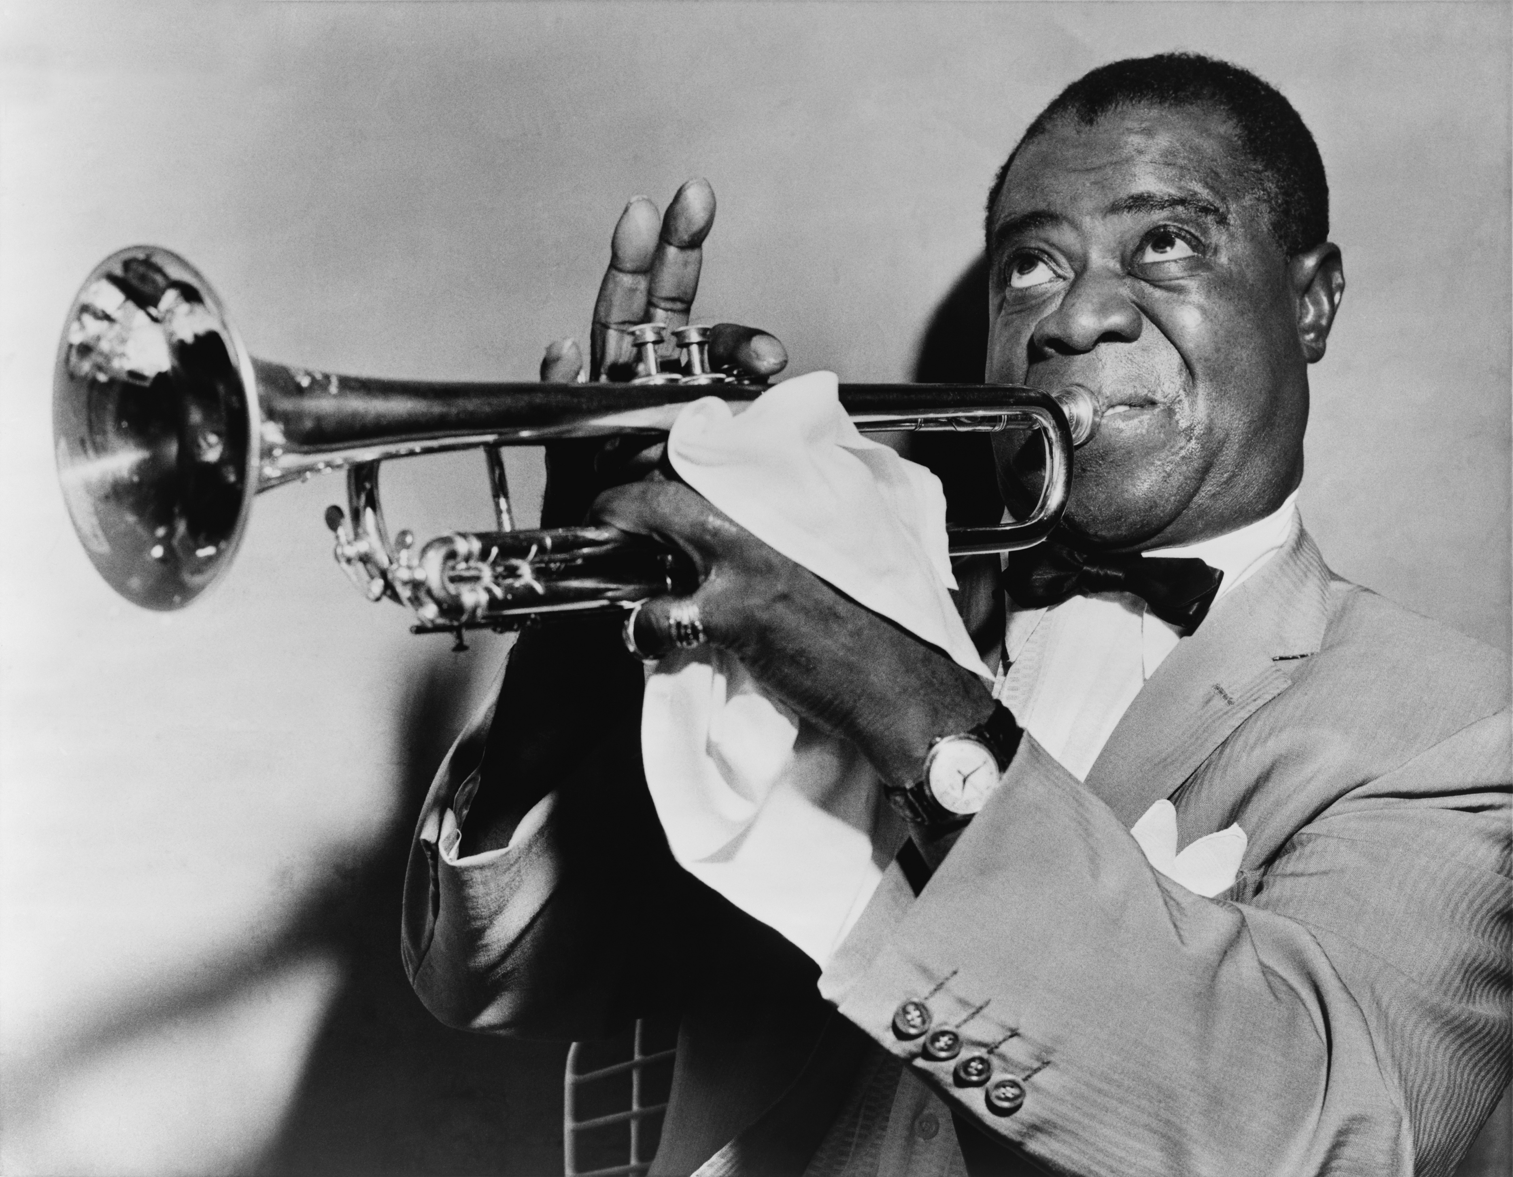
The Harlem Renaissance
Collectively celebrated African American music, poetry, theater, and art
Langston Hughes
Literary work flourished during the Harlem Renaissance
Jazz Artists
Duke Ellington
Louis Armstrong
Trumpet

Slide 13
Flappers
Flappers
Free-spirited women newly liberated in part because of their work experience during World War I
Wore shorter skirts, short bobbed hair, and heavy makeup
New Dances
Charleston and Lindy Hop
New Music
Tin Pin Alley

Slide 14
Hollywood
Hollywood and the 20’s
First Movies
Featured subtitles and in house organist to heighten the drama
Talkies
Douglas Fairbanks
Charlie Chaplin
Gloria Swanson

Slide 15
Hollywood.
The Jazz Singer
First full-length feature motion picture with sound
Starred Al Jolson
Music and Movies
Movies spread music to a wider audience
Composers on the rise
Irving Bell
Harry Warren

