Slide 1
Vietnam War Era
State Standard 10.3

Slide 2
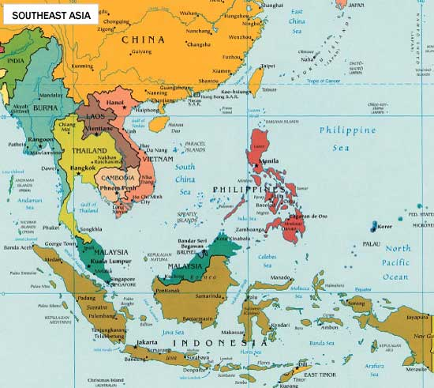
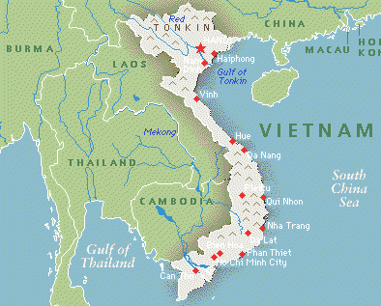
Southeast Asia
Countries of Southeast Asia
Breakup of colonial empires leads to new governments
Left vulnerable to the spread of Communism

Slide 3
Vietnam War
Vietnam
Originally a French Colony
After WWII France tries to retake Vietnam but fails
Vietnam spilt into two countries
Communist North Vietnam
Supported by Soviet Union and Communist China
South Vietnam
Supported by US and its allies
Vietnam War was primarily a civil war with North Vietnamese seeking reunification of the country under Communist rule

Slide 4
Vietnam War.
US and Vietnam
US never formally declares war against Vietnam
Even though war was not declared thousands of US troops were involved in the nearly twenty year struggle
Gulf of Tonkin Incident
1964
US Navy ships attacked by North Vietnamese
President Lyndon B. Johnson received support from Congress to escalate US involvement in the war

Slide 5
Vietnam War..
The Draft
High casualty numbers led to the institution of the draft
Young men who never dreamed of going to war were trained and sent to war
Many object and run off to Canada
Draft Dodgers
Many openly revolt
Burning draft cards and refusing to fight if selected

Slide 6
Vietnam War…
Conflicting Opinions
Some saw refusing to fight as supporting Communism and being Un-American
Other see agreeing to go fight as being weak-willed or supportive of an unjust war fought by a government that did not care about the people it killed

Slide 7
Anti-War Sentiment
Government Response
Surprised by amount of protest
Government investigates leaders of the movement
This leads to greater distrust of government
Lyndon B, Johnson decides not to run for reelection because of the anti-war protests

Slide 8
Political Change
1968 Presidential Election
Richard Nixon elected new President
Resulted from a conservative movement in the country
Nixon pledges to represent the “silent majority”
Wished to restore law and order to society

Slide 9
Turning Point In Vietnam
Tet Offensive
All out attack against several major cities, military bases, and airfields by the North Vietnamese
South Vietnamese and Americans repelled the attacks
Tet Offensive shocked the American people
Television
Brought graphic images of the fighting into American homes
Many think America has no chance to win
Turning point in the war

Slide 10
Anti-War Protests
College Campuses
Dissent on college campuses up to this time had been peaceful
Peaceful protest become mixed with tense confrontation and even violence

Slide 11
Anti-War Protests.
May 1970
Kent State University
Ohio National Guardsmen kill four student protestors at a rally
Jackson State in Mississippi
Police kill two protesters
University of Wisconsin-Madison
Powerful bomb explodes killing a physics researcher and damaging buildings
People responsible for the bombing considered it a justified act of civil disobedience

Slide 12
Anti-War Protests..
Public Opinion
Altered how people viewed both the government and protestors
Signaled an end to anti-war protests
Nixon begins to withdraw American troops from Vietnam

Slide 13
End of the War
War ends in 1975
South Vietnamese surrenders to the North Vietnamese Army
58,ooo Americans, two million Vietnamese civilians, one million North Vietnamese fighters, and over 200,000 South Vietnamese fighters were killed

Slide 14
End of the War.
Negative Effects
Agent Orange
Herbicide used in mass quantities to deforest opposition territory
Increases incidents of cancers, skin diseases, and malformations to people exposed to it
North and South Vietnam form the Socialist Republic of Vietnam

