Slide 1
World War I
The War to End All Wars

Slide 2
June 28, 1914
Archduke Francis Ferdinand
Heir to the throne of Austria-Hungary
Assassination of the Archduke and his wife led directly to World War I
There were also many other factors that created an atmosphere of tension

Slide 3
Causes of World War I
Crisis following assassination led directly to the conflict
Many factors helped create an atmosphere of tension in the decades before 1914
MAIN
Militarism
Alliance System
Imperialism
Nationalism
http://videos.howstuffworks.com/hsw/17205-world-war-i-roots-of-war-video.htm

Slide 4
Growth of Nationalism
Nationalists saw their own countries as superior and looked toward other countries with hostility
Governments willing to go to the brink of war to protect their “national honor”
Citizens ready to die for their country

Slide 5
Industrialization
Transition of society from rural to urban
Industrialization accelerated economic competition among European nations
Led to an increased production of military supplies

Slide 6
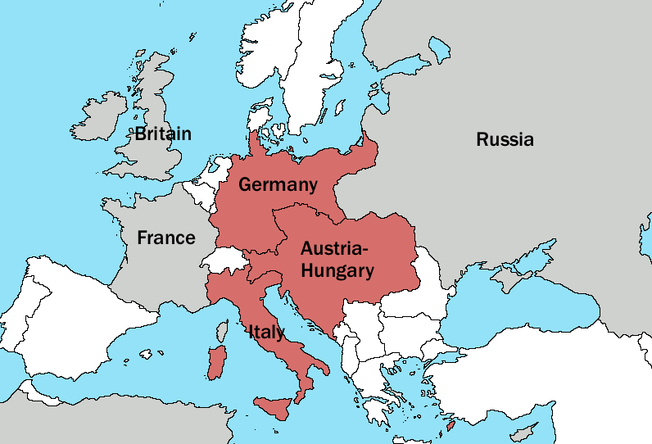
Alliance System.
Central Powers
Defensive Alliance
Countries involved would come to each other’s defense should one be attacked
Linked Germany, Austria-Hungary, and Italy

Slide 7
Alliance System..
Allied Powers
Britain, France, and Russia
Was not a defensive alliance
Informal Alliance

Slide 8
Militarism
Germany increases the size of its Navy
Britain responded by building up its Navy
Britain is an island nation
Felt that any increase in a Navy’s size was an attack on their country

Slide 9
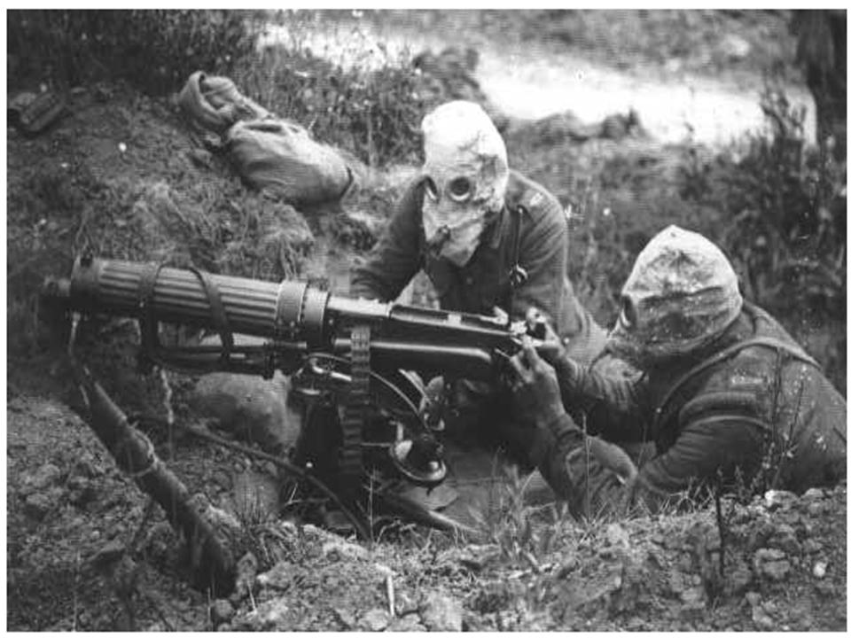
Militarism.
More European Powers begin to increase the size of their militaries
New technologies and industrialization leads to mass production of new weapons
Poison Gas
Machine Guns
Tanks
Also begin to plan for what to do in the case of war

Slide 10
Imperialism
Imperialism
Taking over smaller countries and exporting their goods and resources to your country
Morocco
Germany challenges France in Morocco
Britain supports France in this crises because of the Triple Entente
Surprised the Germans who expected Britain to abandon France
Results in the two countries coordinating their militaries together

Slide 11
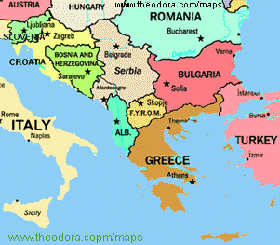
The Balkans
European countries begin to focus on the Balkan area of southeastern Europe
Russia and Austria-Hungary had long been rivals in this area
The spread of nationalism to the Balkans complicated this rivalry even more

Slide 12
Emergence of Serbia
Serbia looked to take land from Austria-Hungary where a large portion of Serbs lived
Austria-Hungary
Viewed Serbia as a “Serbian menace”
Did not want to let their territory go to the Serbian government
Would have been an insult to their national pride

Slide 13
The Black Hand
Serbian Nationalists society aimed at taking down Austria-Hungary and gaining from them the land that their fellow Serbs inhabited

Slide 14
The Assassination
Archduke Francis Ferdinand
Heir to the throne of Austria-Hungary goes to inspect troops in Sarajevo
Sarajevo was a city in Bosnia, part of the Austro-Hungarian empire
Contained a large population of Serbians

Slide 15
The Assassination.
The Archduke was set to travel into Bosnia by an uncovered car
His route was published before hand so everyone knew where he was going
7 Conspirators of The Black Hand take their places along the road to attempt to assassinate him

Slide 16
The Assassination..
First Attempts
The Black Hand Conspirators throw bombs at the car but it bounces off and blows up the next car in the convoy
People in the next car are severely injured and have to be rushed to the hospital

Slide 17
The Assassination…
The car with the Archduke and his wife speeds to the City Hall to review the troops
After leaving the City Hall the driver goes on a new route to take them out of the city safely
The Archduke is upset and commands the driver to stop because he wants to go to the hospital to visit the people injured in the first assassination attempt

Slide 18
The Assassination….
The Archduke’s car stops in front of a coffee shop to change directions
In the coffee shop was the Black Hand member Gavrilo Princip
Princip was upset because his earlier attempt had failed
When he walked out of the shop he saw the Archduke
He pulled out his automatic pistol and walked to the car and fired two shots

Slide 19
The Assassination…..
First bullet strikes the Archduke’s wife Sophia in the abdomen (she was an expecting mother)
Second bullet strikes the Archduke close to the heart
The Archduke’s last words were “Sophia…”
Both die instantly

Slide 20
The Assassination……
Gavrilo Princip is captured immediately
Tortured
Convicted of killing the Archduke
Was too young to receive the death penalty
Dies in prison in 1940

Slide 21
To War
Germany pledges to support whatever action Austria-Hungary deemed necessary
“The Blank Check”
Offered because of Alliance
On July 28, 1914 Austria-Hungary declares war against Serbia
http://videos.howstuffworks.com/hsw/5529-world-war-i-austria-hungary-declares-war-video.htm

Slide 22
To War.
Russia comes to Serbia’s aid against Austria-Hungary
Russia assumed that war with Austria-Hungary would mean war also with Germany so they mobilized for war against both countries
Germany becomes alarmed and assumes that war with Russia would also mean war with France issues ultimatums to both
August 3, 1914 Germany is at war with Russia and France

Slide 23
To War..
Britain Hesitates
Britain refuses to enter the conflict until Germany invaded Belgium
This violated an agreement that ensured Belgium’s permanent neutrality

Slide 24
To War…
Why invade Belgium?
Germany’s war planned called for the invasion of Belgium
They claimed it was a pivotal point in their offensive
Italy Scared
Italy refuses to act because they agreed to help only if the other countries were attacked

Slide 25
Central vs. Allies
Allies possessed greater manpower, industrial strength, and access to resources
Central powers needed a quick war not a long drawn out war if they were to have a chance to win

Slide 26
Germany Invades…And Fails
Invasion
Germany invades by marching men through Belgium into France
Germans are stopped outside of Paris at The First Battle of the Marne
This denied Germany a quick victory and caused it to fight a prolonged two front war

Slide 27
Bloody Deadlock
Short war illusion starts to fade
Both sides dig in
Create an opposing system of trenches
Began to try and break through each others lines by using direct assaults
New and improved weapons made this a suicide mission
http://videos.howstuffworks.com/hsw/17145-world-war-i-european-conflict-video.htm
http://videos.howstuffworks.com/tlc/31495-battle-science-world-war-i-camouflage-video.htm

Slide 28
Trench Warfare
Both sides dug in to avoid machine gun fire
Resulted in trench warfare
No Man’s Land
Unoccupied land between opposing trenches that no one controlled
Barbed Wire
Commonly used to defend positions
Mud
Constantly a problem because of the wet climate

Slide 29
Western Front
Offensive at Verdun
Assault against the French fortress city of Verdun with the goal of “bleeding France white” and forcing her out of the War
375,000 French Die
335,000 Germans Die

Slide 30
Western Front.
British Attack
Battle of the Somme
British go on the offensive but are unable to break through
420,000 British casualties
200,000 French casualties
450,000 German casualties
Resulted in no gain for either side
http://www.history.com/topics/battle-of-the-somme/videos#1916-battle-of-the-somme

Slide 31
Resort to Total War
1917-1918
Allies and Central Powers refuse to make peace
Only way to win was to change the economy to an economy totally devoted to supporting the war
Used all resources and labor for war related goods
TOTAL WAR

Slide 32
Revolution in Russia
Czar Nicholas II
Abdicates his throne ending the Romanov’s 304 year dynasty
Bolsheviks, a revolutionary Marxist Socialist Party under Lenin, establish a new government in Russia
Executed the Czar and his family
Treaty of Breast-Litovsk
Separate peace with Germany

Slide 33
US Enters the War
Factors leading America to war
Zimmerman Note
Sinking of the Lusitania (128 Americans killed)
http://www.history.com/videos/u-boats-sink-the-lusitania-in-1915#u-boats-sink-the-lusitania-in-1915
Unrestricted Submarine Warfare

Slide 34
Zimmerman Note
Arthur Zimmerman
German Foreign Secretary
Sends note to German ambassador in Mexico
Proposed an alliance with Mexico if the US abandons neutrality
Promised to return land the US had taken to Mexico

Slide 35
The Lusitania
German Warning
Germany warns it will sink any vessel entering or leaving a British port
Lusitania
Passenger liner sunk by German U-Boats
128 Americans die

Slide 36
US Enters the War.
Germany tries to end the war before American soldiers and Marines can arrive
Marines win at Belleau Wood
http://videos.howstuffworks.com/military-channel/5145-20th-century-battlefields-1918-western-front-2-video.htm
Once America arrives the fresh troops help quickly defeat the Central Powers

Slide 37
US During the War
National Defense Act
Increased the size of the military and supplied money to build a Navy
Selective Service Act
Authorizes a military draft that required drafted soldiers to serve until four months after the President declared peace
Espionage Act
Made it a crime to interfere with the induction of soldiers or to knowingly refuse the draft

Slide 38
US During the War.
Sedition Act of 1918
Became a crime to speak out, write, or engage in any activity contradictory to the government’s war efforts
Pacifist and Socialists spoke out against the war and were jailed
Eugene Debs

Slide 39
US During the War
Participation in war effort seen as patriotic
Victory Gardens
Price Controls
Rationing
Liberty Bonds

Slide 40
End of the War
Germans Surrender
November 11, 1918 and 11 AM
Eleventh hour of the eleventh day of the eleventh month
The war cost 8 million lives
20 million people were wounded
Treaty of Versailles ends the Great War
http://www.history.com/topics/battle-of-the-somme/videos#treaty-of-versailles-end-world-war-i

Slide 41
Treaty of Versailles
The Big Four
David Lloyd George
Britain
Clemenceau
France
Woodrow Wilson
America
Orlando
Italy
Met to decide the fate of Germany at Versailles

Slide 42
Treaty of Versailles.
Wilson’s 14 Points
Wilson’s view on how the world should be set up
14th point provided for the creation of the League of Nations
Meeting place where all nations could come to discuss problems

Slide 43
Treaty of Versailles..
War Guilt Clause
Germany had to admit that it was totally responsible for the war
Also made to make REPARATION PAYMENTS
Used to pay for the damage the war had caused

Slide 44
Treaty of Versailles…
America never joins the League of Nations
Reparation payments were too high and led to Germany becoming insanely poor
Wheelbarrows of money needed to buy bread
Terms of the Treaty of Versailles leads directly to World War II

