Slide 1
World War II
State Standards 8.5, 8.7, 8.8, 8.9, and 8.10

Slide 2
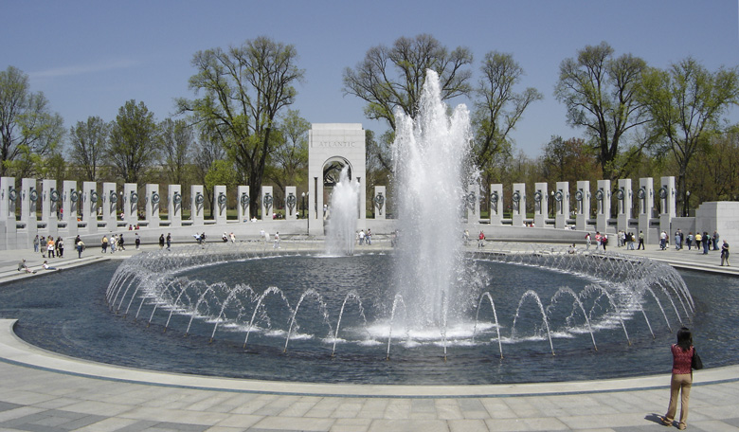
World War II
1939-1945
Axis Powers
Germany, Italy, and Japan
Allied Powers
France, Britain, US, Soviet Union

Slide 3
Lebensraum
Lebensraum
“Living Space”
Referred to Germany’s desire to expand their borders to conquer new living space

Slide 4
Response to Lebensraum
France and Britain’s response
Were tired of war from WWI
Appeasement
Wanted to appease Germany’s desire for more land

Slide 5
Response to Lebensraum.
Treaty of Versailles
Provision that did not allow Germany an air force or offensive army
Hitler secretly builds an air force and offensive army
Eventually announces to the world he had an army and air force
France and Britain chose not to respond
League of Nations condemned Germany for violating the treaty
Failure of the League on Nations

Slide 6
Hitler on the Move
Hitler invades the Rhineland
Hitler invades the Sudetenland
Hitler invades Czechoslovakia
France and Britain refuse to act
Promise Poland that if Germany invades they will come to their aid

Slide 7
Agreement With Russia
Germany and Russia
Secretly agree to divide Poland in half between each other
Nonaggression Pact
Hitler thought that since he had Russia on his side then Britain and France would refuse to do anything about his invasion of Poland…

Slide 8
Mussolini Attacks
Ethiopia
Wanted to restore Italy to being a powerful empire
Invades Ethiopia in 1935
Mussolini declares war on the Allied Powers
Invades Greece but unable to occupy the country
Hitler has to intervene to save Italy from defeat

Slide 9
German Army
Driven by Lebensraum
Hitler dedicated to offensive warfare
Other countries were dedicated to defensive warfare
Fixed Positions
High emphasis on defensive firepower

Slide 10
Blitzkrieg
German offensive warfare
Gain victory as quickly as possible with the least amount of German casualties
Panzer Forces
German tanks would crash through defensive lines at top speed
http://military.discovery.com/videos/top-ten-tanks-mk-iv-panzer.html
Motorized Infantry
Infantry in trucks would come in right behind the Panzers to allow the tanks to continue their advance
Regular Infantry
Advance on foot so to allow Motorized infantry to continue on
http://www.5min.com/Video/World-War-II-Invasion-of-Poland-1354517

Slide 11
Invasion of Poland
Germany’s Panzers vs. Polish Calvary
Case White
Polish Calvary forces charge German tanks with their swords
Russians also invade from the east

Slide 12
Invasion of Poland.
World doesn’t realize how powerful the Blitzkrieg is
Blame Poland’s military and planning for its defeat
Germany defeats Poland in 26 Days!

Slide 13
World Responds
Britain and France dedicated to defensive warfare
Refused to send any aid to Poland
Maintained their defensive strategy and let Poland fight on its own
Russia realizes Germany’s Power
Had agreed to spilt Poland
Stalin is scared and worried about a German invasion of Russia

Slide 14
Target…France
Blitzkrieg
Unleashed against Belgium and the Netherlands
Takes 10 days to capture these two countries
France and Britain try to reinforce the countries but fail
Become surrounded

Slide 15
Dunkirk
Germans rapidly advances into France
Trapped troops decide to try to flee to Britain
338,000 troops escape from France into Britain
Were able to escape because the British Navy and civilians had sailed across the Channel to evacuate them
The climax to an epic defeat

Slide 16
Conquest of France
Blitzkrieg
Unexpected Success
France falls in 35 days
The success of the invasion was determined in the first week
Reason for quick defeat
France lacks necessary armed forces and misused the ones that they had

Slide 17
French Resistance
Charles de Gaulle
Escaped to London
Organized his own government in exile for France

Slide 18
The “Jewish Question”
Hitler’s Plan
Hitler planned to remove all Jews from Germany
Hitler first created many restrictions on Jews
This was done to encourage their relocation on their own

Slide 19
Kristallnacht
Jew assassinates German official in Paris
Kristallnacht results
“Night of Broken Glass”
Nazis break into Jewish businesses and destroy them and burn synagogues
Results in mass Jewish emigration from Germany

Slide 20
The Final Solution
Hitler’s Choice
The Final Solution
Hitler chooses extermination as the final solution for the Jewish population in Germany

Slide 21
Carrying out the Final Solution.
Establishment of death camps that use gas to kill
Auschwitz
Largest death camp that was built in Poland
Camps use hydrogen cyanide to kill prisoners

Slide 22
Carrying out the Final Solution..
At first only Jews unfit for work were killed
Towards the end of the war all Jews are being killed
In all possibly as many as 5.8 million Jews were killed during the Holocaust

Slide 23
Battle of Britain
Germany focuses on Britain
Bombing campaign against Britain
Operation Sea Lion
Night bombing of London and major cities
Known as “The Blitz”
First German failure in WWII

Slide 24
Germany Invades Russia
June 22, 1941
Germany Invades Russia
Operation Barborossa

Slide 25
To Moscow!
German Army pushes to capture Moscow
Scorched Earth Policy
Battle of Stalingrad
Russians stop the German advance
200 day battle
Bloodiest battle of WWII
Germany begins to retreat

Slide 26
The Pacific
Battle of Midway
US Navy halts the advance of the Japanese by winning the land and sea battle at Midway

Slide 27
The Pacific.
Guadalcanal
US Marines invade
Successful in taking the island but most hold it
Japanese counterattack
Marines burn all official documents because they think they are going to be defeated
Marines hold out
John Bassilone
Chesty Puller

Slide 28
The Pacific..
Iwo Jima
Island 650 miles from Japanese homeland
Meant to support not life, but death
Defended by Lieutenant General Kuribayashi
Fortification specialists had created the island’s defenses

Slide 29
The Pacific…
Iwo Jima
February 19th 1945
Marines storm the beaches
Marines are slaughtered on the beach but some how secure the beach
First Flag Raising
Small group of Marines given a flag to raise at the top of Mount Suribachi

Slide 30
The Pacific….
Iwo Jima
Second Flag Raising
Another group of Marines given a flag to place on top of Suribachi to replace the first flag
Joe Rosenthal, combat photographer, follows the group

Slide 31
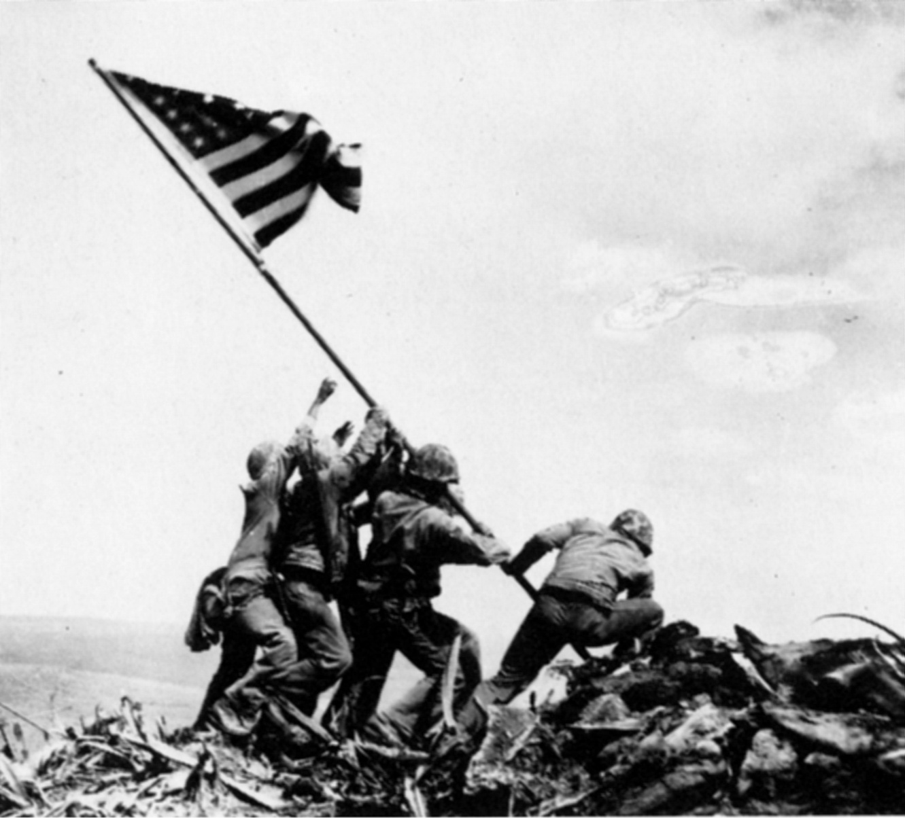
Harlon Block, Rene Gagnon, Michael Strank, Franklin Sousley, Ira Hayes, and John Bradley

Slide 32
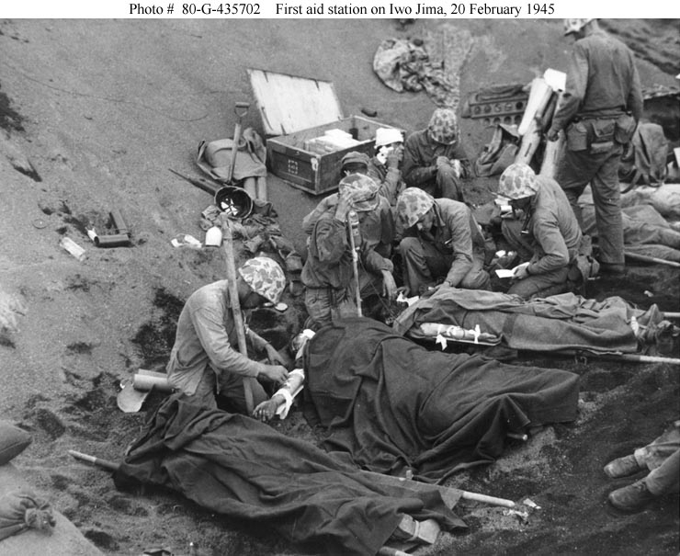
Pacific…..
Battle drags on for another month
6,825 American lives were lost on Iwo Jima
1 out of every 3 Marines were either killed or wounded
Almost all of the 20,000 Japanese defenders died
27 Medals of Honor awarded

Slide 33
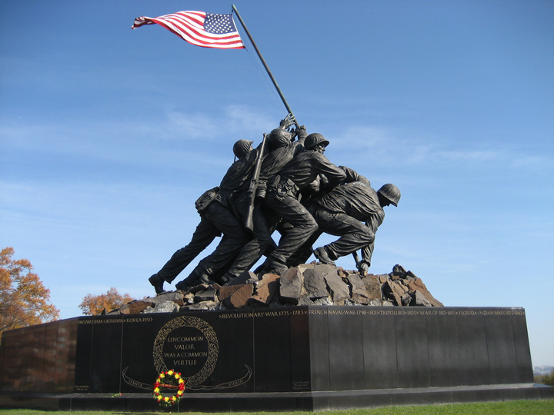
“Uncommon valor was a common virtue”

Slide 34
The Homefront
Post Depression Resolve
US must muster all the determination it can to win World War II
Men dropped out of high school to fight, women worked in factories to produce weapons

Slide 35
The Homefront.
Women in the Military
350,000 women serve in the military
Women’s Army Corps (WAC)
Women Accepted for Volunteer Emergency Service (WAVES)

Slide 36
The Homefront..
$320 Trillion
Amount spent to finance the war
Government mobilizes all industry to produce war equipment
Government spending infuses the economy, lifting it out of the depression

Slide 37
The Homefront…
Government Agencies
War Production Board
Supervised conversion of industry to war production
Obtained raw materials and allotted them to businesses
Office of Price Administration
Supervised consumer prices and managed rationing
Office of War Mobilization
Supervised the efforts of all these agencies

Slide 38
The Homefront….
Rationing
Ration Books
Government begins to ration certain items by giving out coupons
These coupons must be redeemed for items such as sugar, meat, and gasoline

Slide 39
The Homefront……
War Bonds
Americans buy war bonds to help finance the war
Americans provide their scrap metal and rubber for military use

Slide 40
The Homefront…….
Discrimination
Minorities often limited in the type of employment they could find
Executive Order 8802
Banned discrimination in the defense industry
Did not desegregate the armed forces
Executive Order 9981
Desegregated the military (1948)

Slide 41
Preparation for D-Day
Normandy
America chooses Normandy as the place for the invasion
America, Britain, and Canada all participate in the invasion
Led by US General Dwight D. Eisenhower

Slide 42
Operation Overlord
June 6, 1944
Five Beaches selected for the attack
Utah Beach
US
Omaha Beach
US
Gold Beach
Britain and Canada
Juno Beach
Britain and Canada
Sword Beach
Britain and Canada

Slide 43
Omaha Beach
Numerous Problems
Americans encounter fierce resistance
Many boats were landed too far out
These boats flipped and the men drowned
Men who landed in Higgins Boats had to storm the beaches while being shot at from secure positions

Slide 44
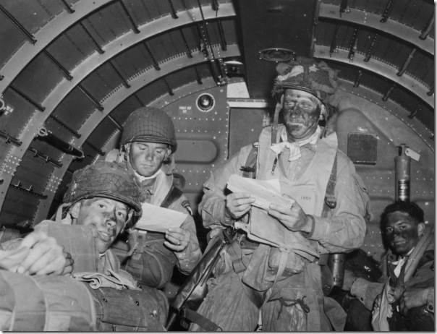
Airborne Assault
Paratroopers
America lands paratroopers the night before the invasion behind enemy lines
These soldiers were responsible for creating havoc behind enemy lines

Slide 45
Buildup and Breakout
Over 100,000 troops land in first two days
Hitler never realized that the invasion at Normandy was the Allies actual invasion

Slide 46
Battle of the Bulge
America slowly advances
Germany is slowly losing ground
Hitler decides to stage one last attack
Hitler weakens his eastern front to be able to attack in the West
RealPlayer

Slide 47
Battle of the Bulge.
Allied leaders did not consider Germany a dangerous offensive force
Allies caught by complete surprise by this new offensive

Slide 48
Battle of the Bulge..
Operation Autumn Fog
Hitler’s name for his final offensive
German spies dressed in American uniforms penetrate American lines and cause confusion
Hitler attacks with a vengeance and almost completely breaks through the American lines

Slide 49
Battle of the Bulge…
Bastogne
US 101st Airborne had quickly been sent to reinforce the city of Bastogne
German troops surround the city
They ask for the 101st surrender
American commander responds to the German request with one word, “Nuts!”

Slide 50
Battle of the Bulge….
Because Bastogne holds out America wins the Battle of the Bulge
German defeat at the Battle of the Bulge means disaster for the German Army
Had lost all of their reserves and severely damaged German morale

Slide 51
Yalta Conference
Meeting at Yalta
February 1945
Stalin, Roosevelt, and Winston Churchill all meet at Yalta (Big Three)
Meet to discuss Germany’s defeat, occupation, and the postwar assistance to its people
Russia agrees to attack Japan once Germany surrenders
Worry that Russian Communism would spread
Alliance between US and Russia becomes tense
Start of the Cold War

Slide 52
Hitler’s End
With America closing in from the West and Russia closing in from the east times become desperate for Hitler
SS Units begin to destroy Death Camps
SS unable to destroy most of the death camps

Slide 53
Hitler’s End.
Bunker Life
Hitler moves his headquarters to an underground Bunker in Berlin
Developed a stoop, suffered from tremors in his limbs, and dragged his leg when he walked
Comes under the influence of a quack doctor who gave him large dosages of drugs and pills

Slide 54
Hitler’s End..
Ordered Destruction
Hitler orders the destruction of everything that the Allies could possibly use after they conquer Germany
Hitler still visualized a miraculous turnabout in the war
He talked about new counteroffensives using armies that existed only on paper

Slide 55
Hitler’s End…
Marriage
Hitler marries his long time mistress Eva Braun
Last Political Testament
Hitler expelled Goering and Himmler from the party as traitors

Slide 56
Hitler’s End….
Suicide
Hitler and Eva retire to their private quarters
Hitler tests his poison on his German Sheppard
Eva poisons herself
Hitler poisons himself and then shoots himself in the mouth with his pistol
Aides burn their bodies

Slide 57
Japan Becomes Desperate
Kamikaze Assault
Japanese suicide bomber begin to attack the American Fleet at the Battle of Okinawa
Sunk 34 American ships and damaged over 350
RealPlayer

Slide 58
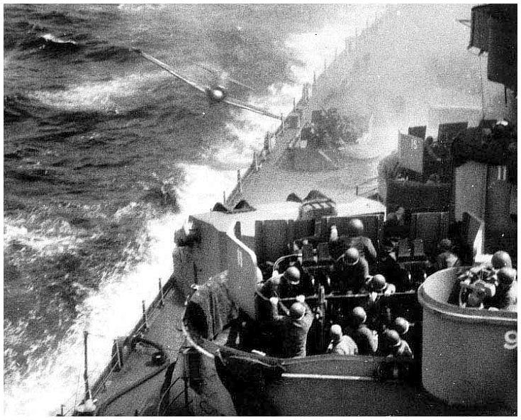

Slide 59
Atomic Bomb
Manhattan Project
$2 Billion Project
Centered at Los Alamos, Texas
Codename for the American push to build an atomic bomb
One of 37 plants helping to build the bomb located in Oak Ridge, Tennessee
Enrico Fermi, responsible for developing the bomb

Slide 60
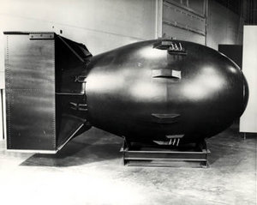
Atomic Bomb.
Two Bombs
“Little Boy” and “Fat Man”
Potsdam Declaration
America calls on Japan to surrender or face “complete and utter destruction”

Slide 61
Atomic Bomb..
Japan refuses to surrender
US now has to choose which two cities to use the bombs on
After much debate America chooses two major cities
Nagasaki
Hiroshima

Slide 62
Atomic Bomb…
Hiroshima
Enola Gay takes off from Tinian
Is carrying a 9,000 lbs. nuclear bomb
“Little Boy”
60% of Hiroshima instantly destroyed
100,000 people die instantly

Slide 63
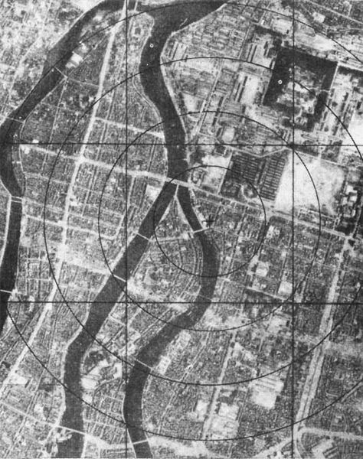
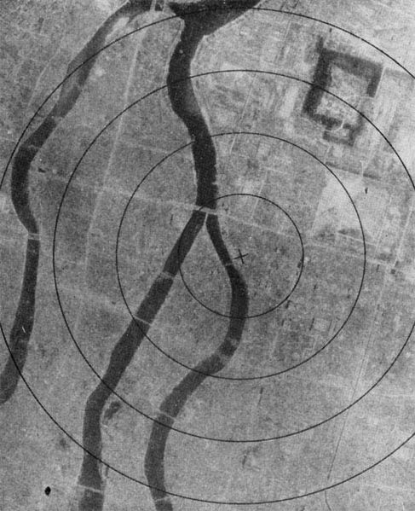

Slide 64
Atomic Bomb….
Nagasaki
Japanese refuse to surrender
Bockscar leaves with “Fat Man” to bomb not Nagasaki but Kokura
Did not bomb Kokura because of poor weather, proceeded on to Nagasaki
Center of city flattened
35,000 die instantly

Slide 65
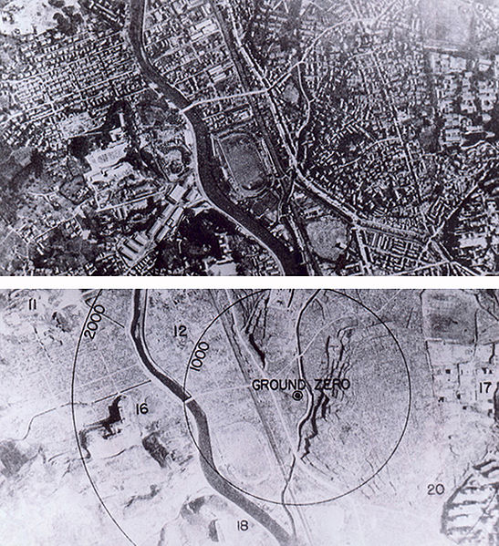

Slide 66
Surrender
August 14, 1945
V-J day
Japan announces its surrender
September 2, 1945
Japan surrenders aboard the USS Missouri in Tokyo Bay
The Atomic Age had begun

